Slide 1
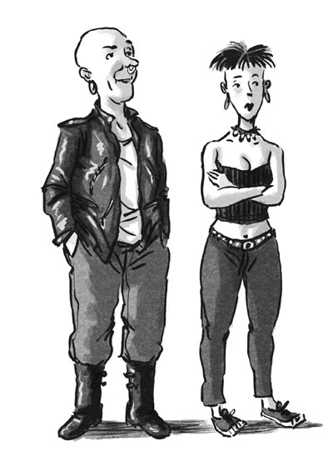
Dress for Success
Solomon/Plains Elementary School’s Dress Code

Slide 2
ACCEPTABLE PANTS 4 POCKETS, 6 COLORS
BLACK
OLIVE/DARK
GREEN
NAVY
BLUE
BROWN
GRAY
KHAKI/TAN

Slide 3
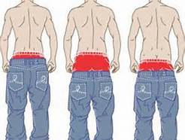
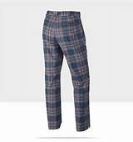
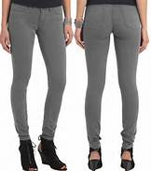
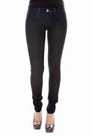
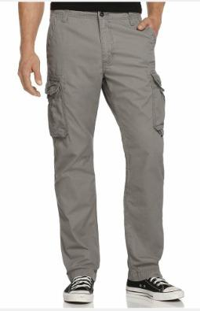
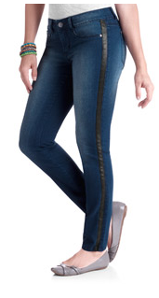
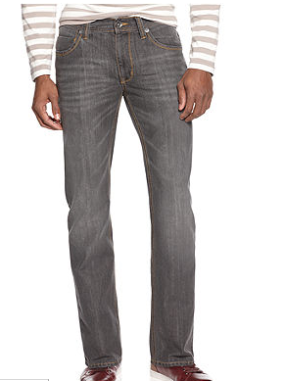
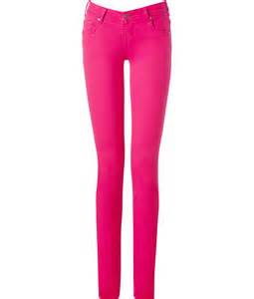
UNACCEPTABLE PANTS
Indecent
Plaid, Stripe…
Jeggings
Skinny
Cargo
Yoga
Jeans
Athletic

Slide 4
ACCEPTABLE SHORTS 4 POCKETS, 6 COLORS
BLACK
OLIVE/DARK
GREEN
NAVY
BLUE
BROWN
GRAY
KHAKI/TAN

Slide 5
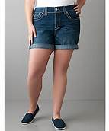
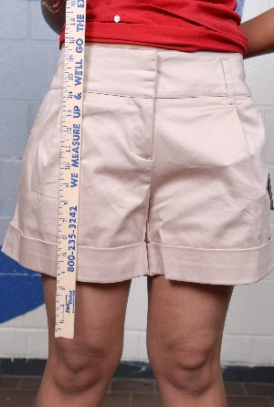
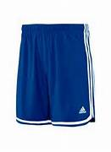
UNACCEPTABLE SHORTS
Too short, jeans
Too short, too tight
Athletic
Cargo
Too short, unacceptable color

Slide 6
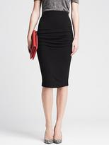
ACCEPTABLE SKIRTS

Slide 7
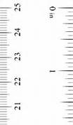
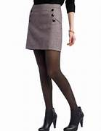
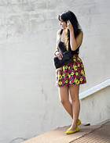
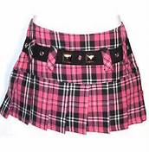
UNACCEPTABLE SKIRTS
No More Than 2 “
above the knee
Too short!
No Plaid!
No florarls!

Slide 8
Ooops, NO!

Slide 9
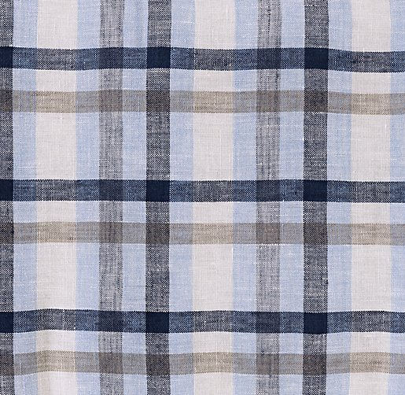
ACCEPTABLE SHIRTS BUTTON UP THE FRONT, COLLARED

Slide 10
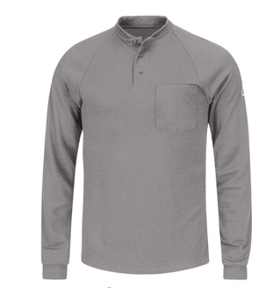
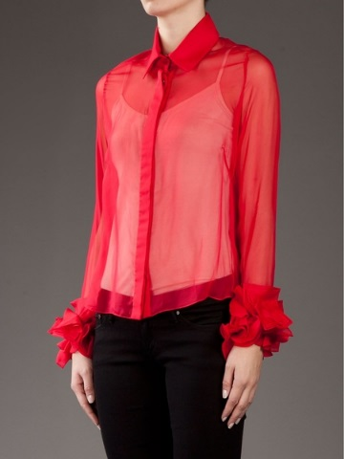
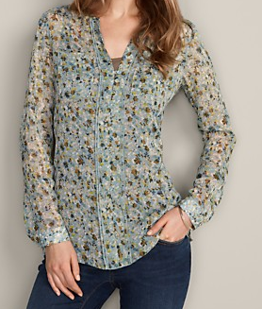
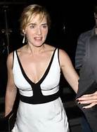
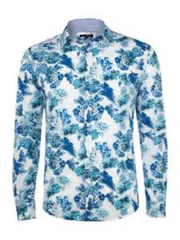
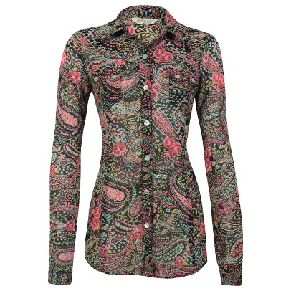
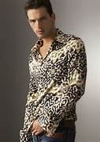
UNACCEPTABLE SHIRTS
NO Henley or
No Collarless
NO Sheer
NO Sheer and
No lower layer visible
Collar but
No buttons
NO Prints
NO Cleavage
NO Floral

Slide 11
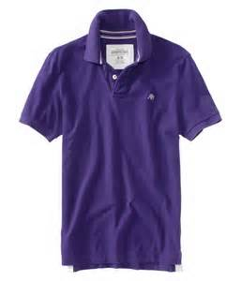
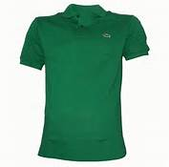
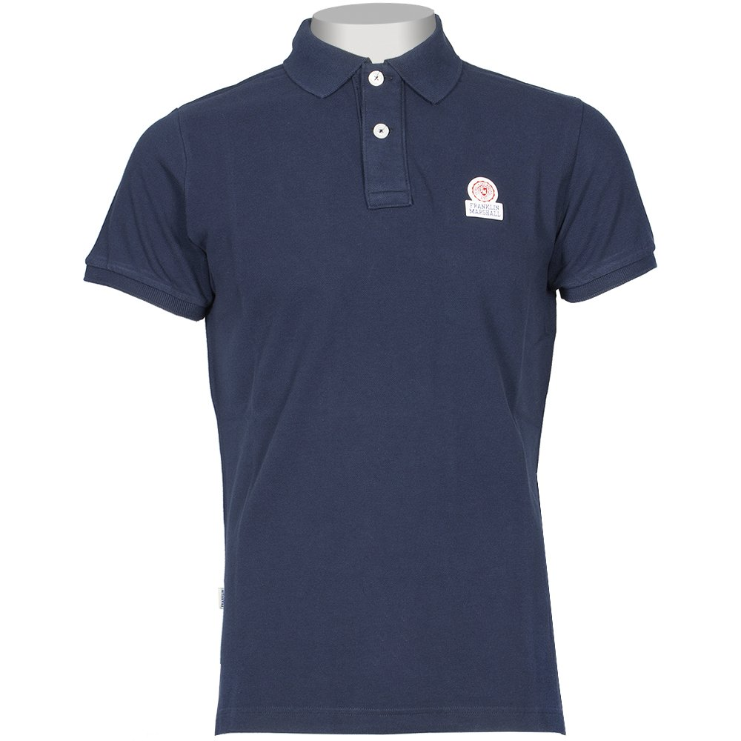
Logos
3”
3”
Acceptable

Slide 12
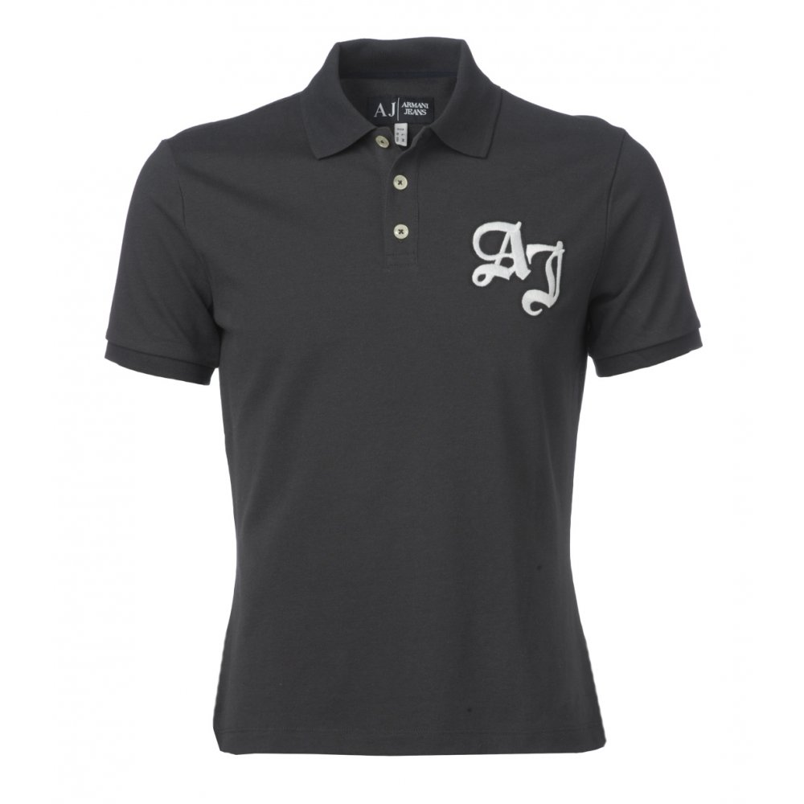
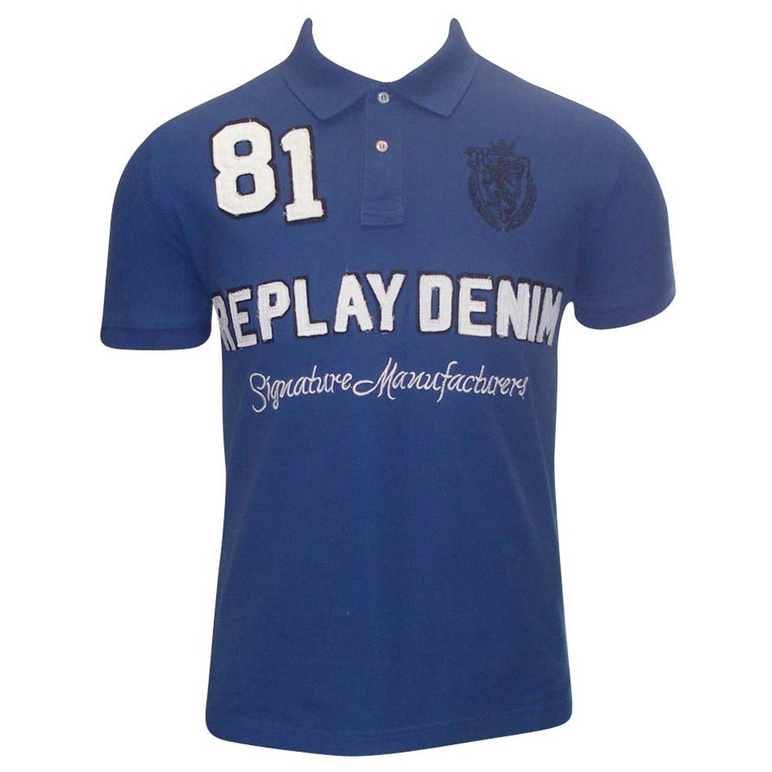
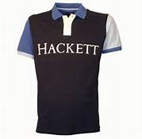
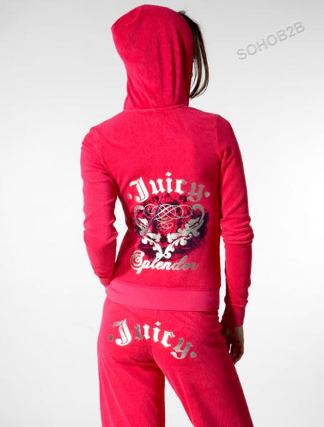
Unacceptable Logos Larger than 3” X 3”

Slide 13
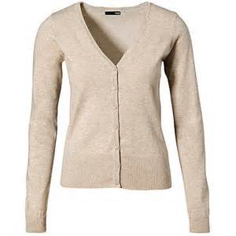
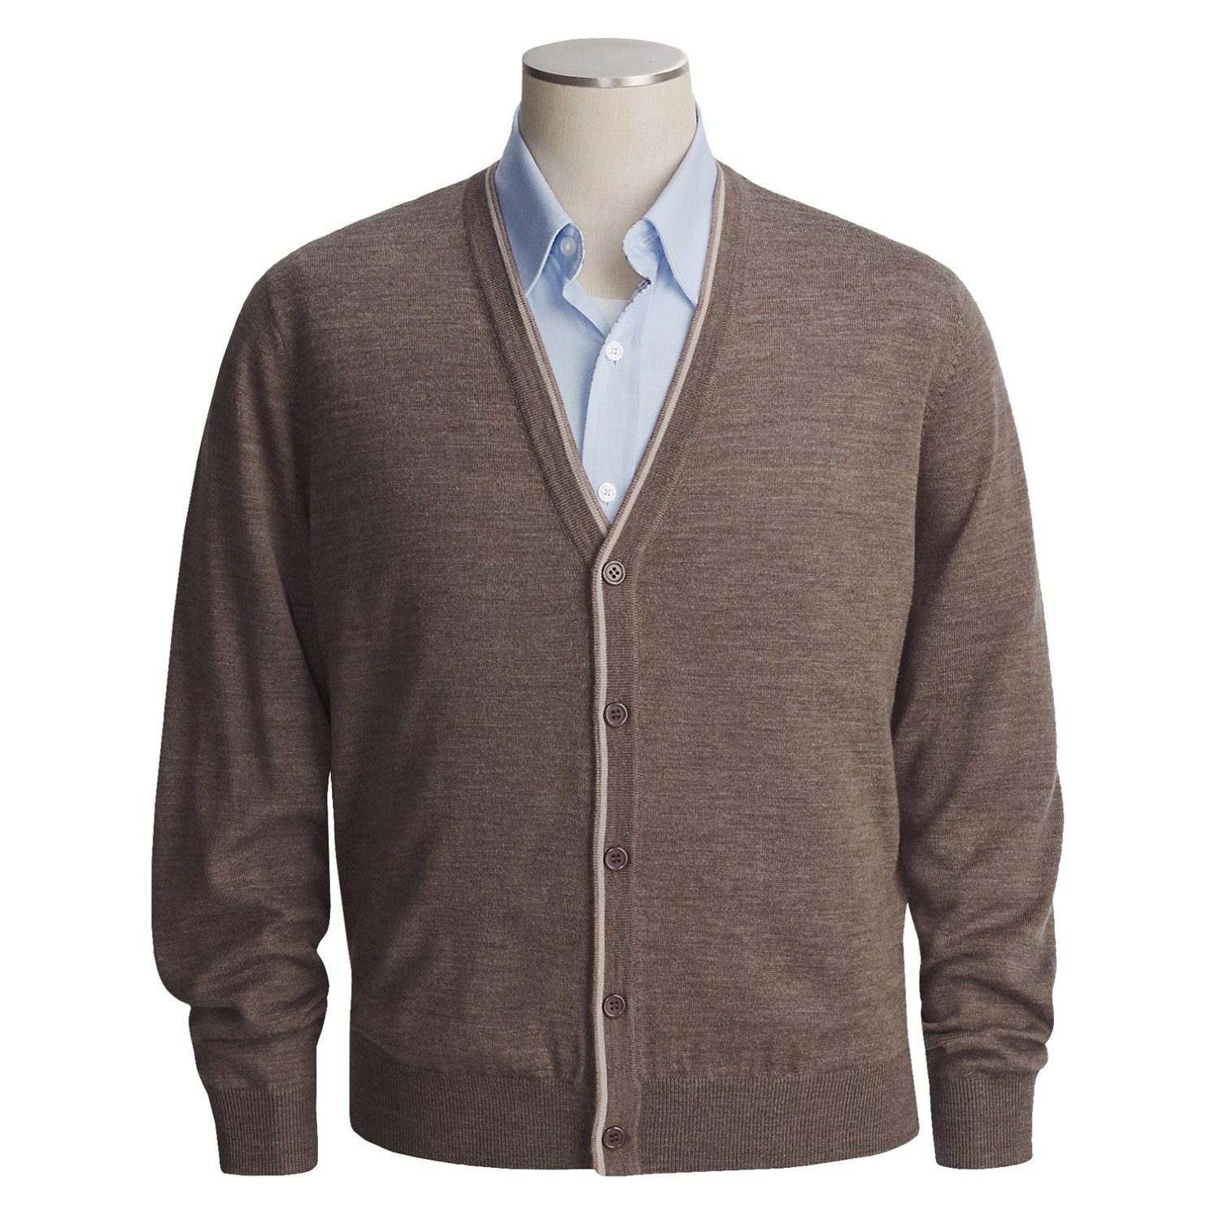
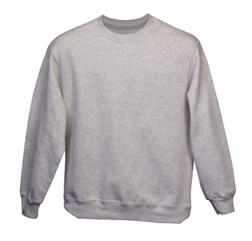
Acceptable Layers
Cardigans
V-neck Sweaters
Crew-neck Sweaters

Slide 14
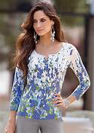
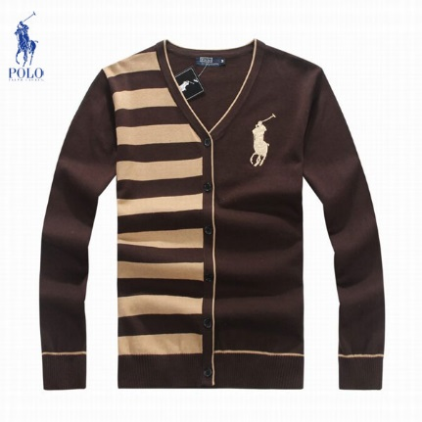
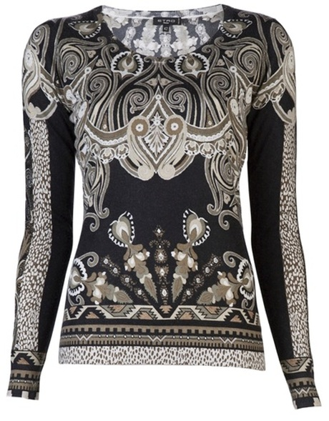
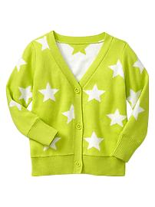
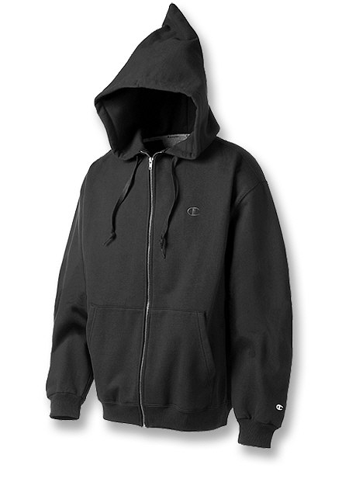
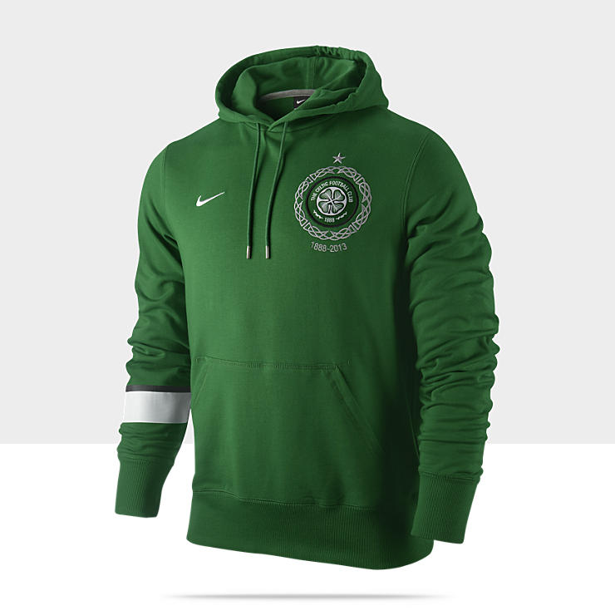
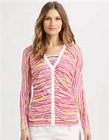
Unacceptable Layers

Slide 15
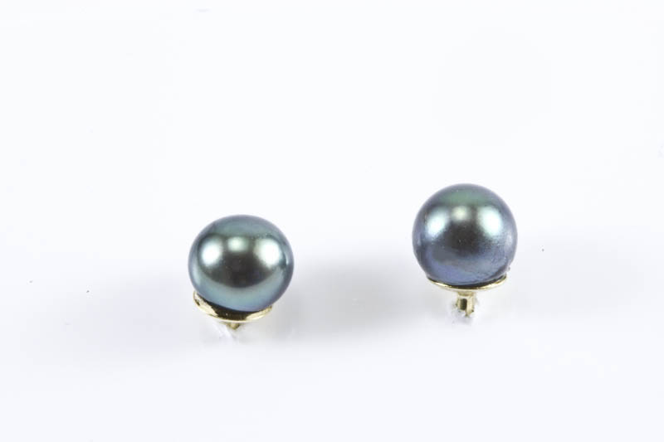
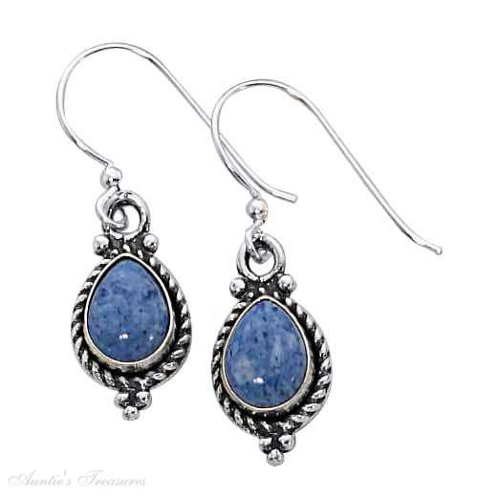
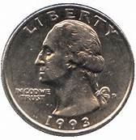
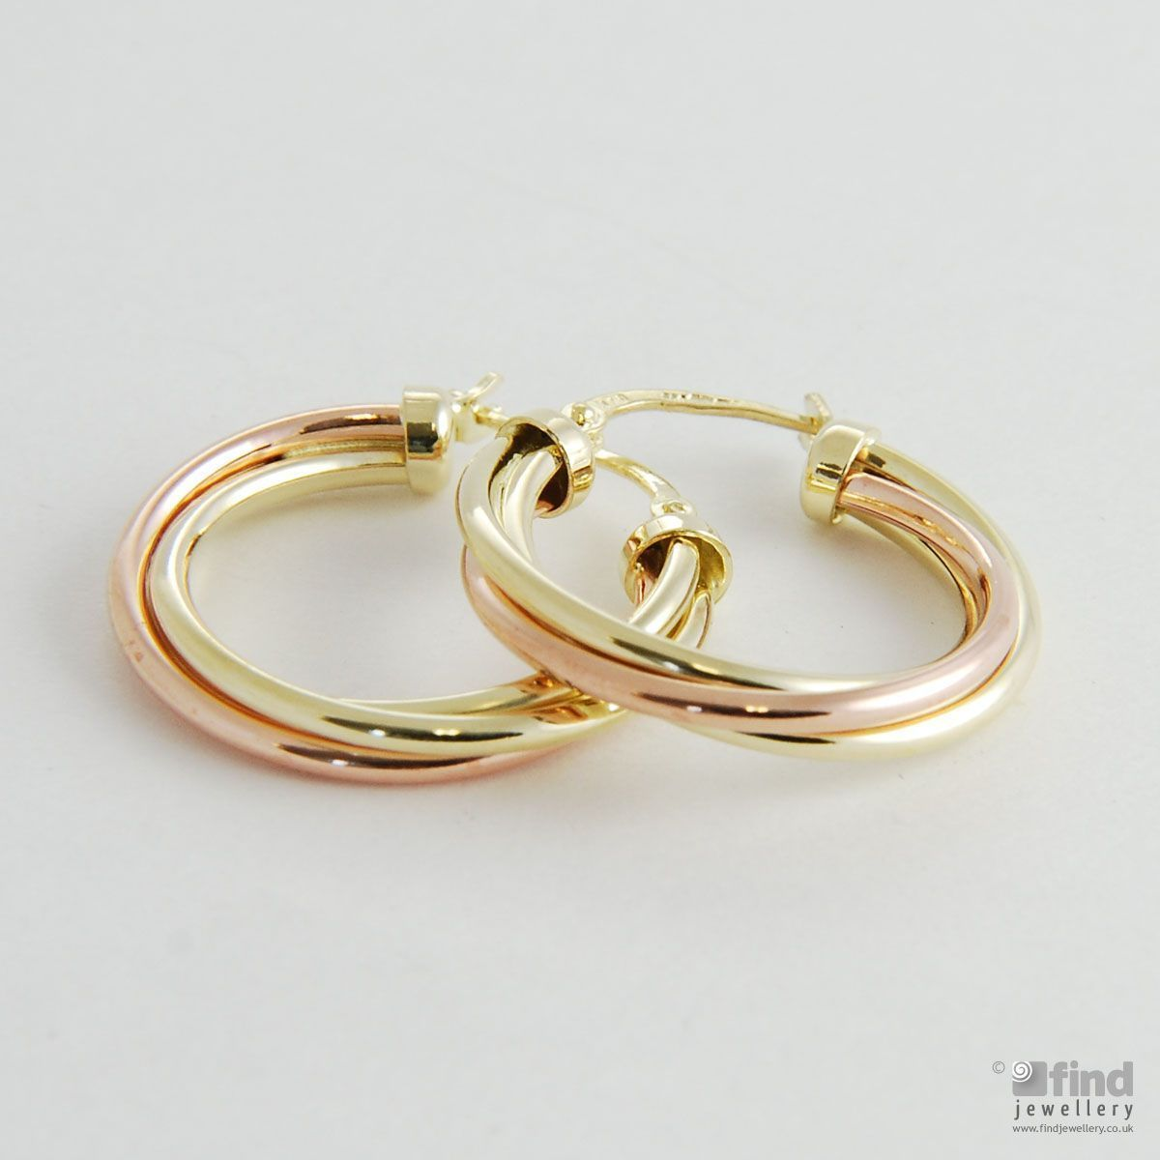
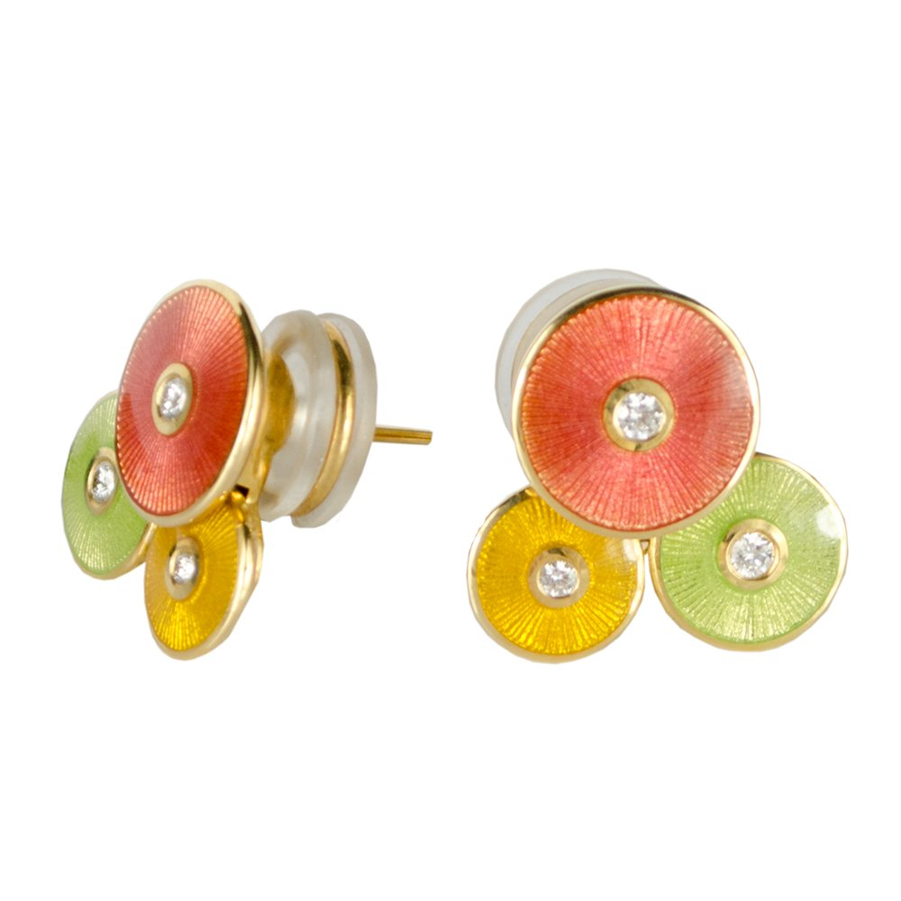
Acceptable Earrings
Earrings NO larger than a quarter

Slide 16
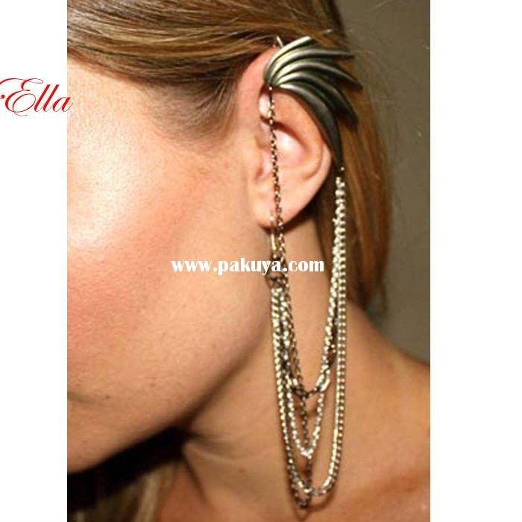
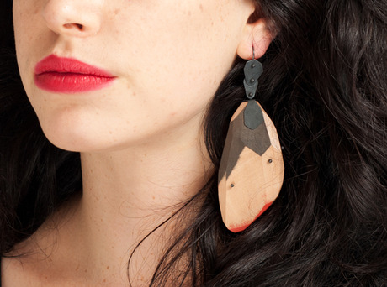
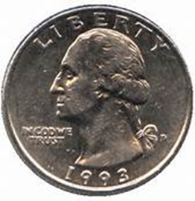
Unacceptable Earrings
Earrings LARGER than a quarter

Slide 17
Acceptable Piercings In Ears ONLY
Single ear piercing
Double ear piercing

Slide 18
Unacceptable Piercings

Slide 19
Dress for Success

