Slide 1
Reading For Context Clues
And Vocabulary Growth
Mastering Reading Through Reasoning
Dr. Arthur Whimbey

Slide 2
Introduction
To understand what you read, you must first know the meanings of the words.
Nothing can disturb your reading more, and confuse you more, than running into one unfamiliar word after another.
One way to increase your understanding of the vocabulary in reading material is to use context clues that surround the word.
Page 2

Slide 3
What are context clues?
Context clues are hints you can find about a word’s meaning by looking carefully at the other words in a sentence.
Example:
Gerard was so hungry that for lunch he consumed three sandwiches and a quart of milk.
The sentence gives context clues (hints) that Gerard was hungry.
He did something with 3 sandwiches and a quart of milk.
You can assume that consume must mean “ate and drank.”
Page 2

Slide 4
Context Clues Resource
Use the folded and cut paper you were handed to create this resource.
In the top section (1) – label it:
CONTEXT CLUES WITH PUNCTUATION
In the second section from the top (2) – label it :
  CONTEXT CLUES WITHOUT PUNCTUATION
In the third section from the top (3) – label it:
    CONTEXT CLUES BY CONTRAST
In the bottom section (4) – label it:
  CONTEXT CLUES INFERRED
1
2
3
4

Slide 5
I Meaning Stated With Punctuation
The simplest kind of context clue is when punctuation marks have been used to set off the meaning of a key word from the rest of the words in the sentence.
Some of the punctuation used to set off meanings are:
a dash or hyphen -- parentheses ( ) commas ,

Slide 6
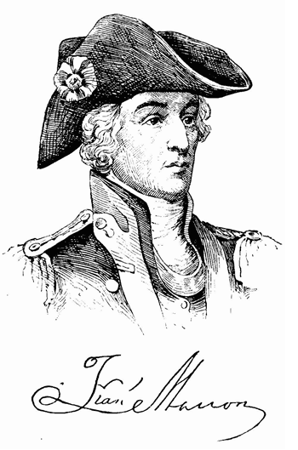
Use of the dash, hyphen and Comma
The “Swamp Fox” got his nickname because he was elusive – hard to pin down and catch.
The meaning of elusive is stated in the sentence.
It is set off by a dash.
Elusive means “hard to pin down and catch.”
  Page 3
Francis Marion

Slide 7
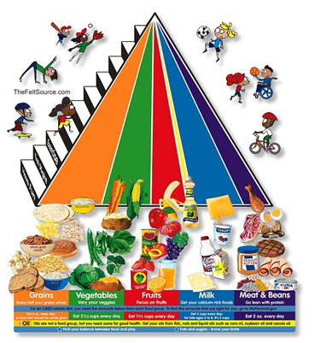
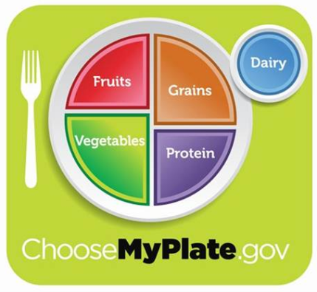
Use of parentheses
Eating properly helps you maintain (keep up) your health.
The meaning of maintain is stated in the sentence.
It is set off by parentheses.
“Maintain” means “keep up.”
Page 3

Slide 8
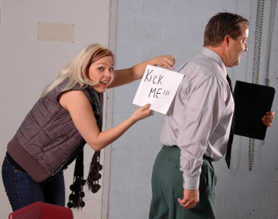
Use of the comma
The teacher asked Lou to stay after school because he pulled a jape, practical joke, on the principal.
The meaning of “jape” is stated in the sentence.
It is set off by commas.
“Jape” means “practical joke.” page 3

Slide 9
Identify the type of punctuation used to set off the meaning of the highlighted word and define the word.
Telling a funny anecdote (a short story) is a good way to begin a speech.
Legislation – the making of laws – is done in the United States by senators and congressmen.
Many soldiers lost their lives in the conflict, or war, between the North and the South.
Set off by parentheses, anecdote means a short story.
Set off by hyphens, the meaning of legislation is the making of laws.
Set off by commas, conflict means war. Page 4

Slide 10
Can you distinguish (tell the difference) between the Greek and Roman buildings?
The company claimed that the amount of chemicals it dumped into the river was negligible – too small to have any effect.
The bottle’s capacity, the amount of liquid it can hold, can be measured in ounces or milliliters.
Set off by parentheses, the meaning of distinguish is tell the difference.
Set off by a hyphen, negligible means too small to have any effect.
Set off by commas, capacity means the amount of liquid it can hold. Page 4

Slide 11
II Meaning Stated Without Punctuation
In Case I, you learned how the definition of a word is often stated in a sentence with the use of punctuation marks.
In Case II, the meaning of the word is again stated in the sentence. BUT in this case it is NOT set off by punctuation marks.
Page 7

Slide 12
A sentence which contains the meaning of the word not set off by punctuation.
Farm country has its own special aroma and when I notice that smell I know I’m close to home and far from the city.
The word “and” tells us something similar is coming.
But the location is not the same so something else is similar.
The sentence mentions the farm’s aroma, then it talks about that aroma as “that smell.”
This context clue shows that “aroma” means “smell.” page 9

Slide 13
What is the meaning of infection?
Dying from an infection was common until modern medicines were developed that could stop the spread of disease in the body.
The clue in this sentence tells you that an “infection” was common until medicines were developed.
The medicine stopped the spread of disease or infection.
This type of context clue is often used in textbooks. Read your textbooks carefully!
Page 7

Slide 14
Build your skills figuring out word meaning stated “without punctuation.”
You should estimate how much time you need to study for a test because a careful guess can help you plan your studying.
Traveling abroad is educational because you can learn a lot from seeing how people in other countries live.
The clue word because tells you that to “estimate” means to guess.
The clue word because tells you that “abroad” means “other countries.” Page 8

Slide 15
Continue building your skills figuring out word meaning stated “without punctuation.”
The earth’s axis is an imaginary line running through its center – from the North to the South Pole – around which the earth spins.
My argument that the project would be too expensive for us to do was also the objection of others.
The context clue is “is” which tells us an axis is “an imaginary line around which the earth spins.
The context clue is “also” which tells us the synonym for objection is argument.

Slide 16
Try a few more!
Cassie took her time when she wrote in cursive, slowly making each word out of an elegant series of arcs and loops.
Cursive is an elegant series of arcs and loops.
Tracy held the flower as gently as she could, fearing that the delicate stem would break.
Delicate means gently.

Slide 17
Let’s Try Again!
Don’t feel contempt or dislike for yourself when you must stop running to catch your breath.
  What signal word is in this sentence?
  What is the meaning of contempt?
Owls are nocturnal. They fly around and look for food at night.
  What is the subject in both sentences?
  When do owls fly around in the second sentence?
  What does nocturnal mean?

Slide 18
Let’s Try a Couple More.
I feel so sad and melancholy on Wednesday mornings, and I don't even know why.
  What is the signal word in this sentence?
  What is the meaning of melancholy?
  When we came into the classroom and saw the little candy bars on our desks, I misconstrued it to mean that we should eat the candy bars before waiting for instructions. I only realized my error after chewing up mine.
  How will you determine the meaning of misconstrued?

Slide 19
III Meaning Given by Contrast
Cases I and II showed how a word’s meaning is often stated clearly in the other words of a sentence.
In Case III, a word’s meaning is again given in the sentence; BUT in this case it is given by contrast in the sentence.
A contrast is a word or idea that is the opposite of the key word. Page 11

Slide 20
Contrast Signal Words:
but
however
yet
though
different from
rather
although
while

Slide 21
Looking for contrast to define words
You should not linger in the theater but should leave immediately when the movie is over.
Locate the contrast signal word.
Leave immediately, the contrast of linger, follows “but.”
Think about the opposite of “leave immediately.”
The meaning of linger is to “hang around.”

Slide 22
In this sentence, the meaning of “unintelligible is contrasted and an example is given.
You should try to write clearly because if your writing is unintelligible people will not understand what you mean to say.
First, an explanation for writing clearly is given.
In the explanation, writing “clearly” is contrasted by unintelligible.
Then an example of unintelligible is given – “people will not understand” what you wrote.
Therefore, “unintelligible” means “unclear, not able to be understood.”

Slide 23
Build your word skills by figuring out word meaning by contrast.
Johnny was besotted in not checking the depth of the water before he jumped in, but it was a good thing his father was wise and checked it first.
Brad made a cursory effort to finish his homework. This was unlike him; usually he worked hard to finish before dinner.

Slide 24
Continue building your word skills by figuring out meaning by contrast.
The omnipotent superhero always won his battles, unlike his weak opponents.
We were all pretty apathetic during the movie about animals, but we became interested when it started showing all the tricks the dogs could do.

Slide 25
Contrast Clues
Some people feel perplexed by brain teasers, while others figure them out quickly.
  What word are we defining?
  What is the contrast phrase?
  What does the clue tell you? Are they the same or different?
  What two things are being compared?
  HOW are the things different?
  What is the meaning of perplexed?

Slide 26
Contrast Clues
Although Tom was anxious about the test, Tina was not worried at all.
  What word needs to be defined?
  What is the contrast phrased?
  What is being compared?
  HOW are they different?
  What does anxious mean?

Slide 27
Even though John had a good job and a nice family, he yearned for more.
Unlike her older brother Jerome, who stayed out all hours of the night, Kate obediently followed the curfew her parents set.

Slide 28
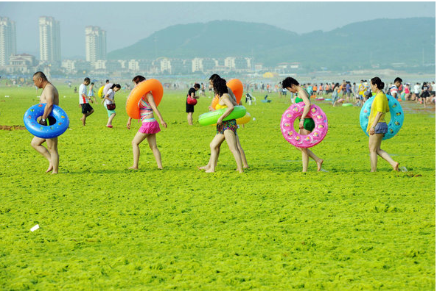
IV Meaning Inferred From Ideas in the Sentence
Inference = what I read + what I already know
                Make a list of all the things you see?
                What do you already know about the things you see?
                Now make a guess as to what is going on in this picture.

Slide 29
IV Meaning Inferred From Ideas in the Sentence
In context clues Cases I, II and III you learned that the definition can be stated directly in the other words in the sentence.
When you come across an unfamiliar word in your reading you should always look for these direct context clues.

Slide 30
The Difference :
In some sentences the meaning of an unfamiliar word will not be directly stated in the sentence.
You can still figure out the meaning of the word by thinking about the ideas in the sentence.

Slide 31
An example:
The diver knew she had won first place when her last dive scored a perfect 10.0, and her elation showed when she hugged her teammates.
The sentence said she won first place and hugged her teammates.
You can infer from these ideas that “elation” must mean “great happiness or joy.”

Slide 32
Another example:
The football star let his agent negotiate with the team owner about a change in his contract.
Activate Prior Knowledge – think about what you know about football stars, agents and team owners.
An agent usually “bargains” with the owner on behalf of his client (football star).
So, we can infer that negotiate means bargain or discuss hoping to agree.

Slide 33
Build your word skills figuring out word meaning by inferring:
Good tools are essential for a car mechanic because they turn otherwise hard jobs into easy work.
Notice the word “because,” it explains why the tools are “essential.”
Essential must mean necessary.

Slide 34
Continue building your word skills figuring word meaning by inferring:
Because the diamond had a flaw it was less valuable.
If the diamond is LESS valuable because of the flaw, a flaw cannot be something good. A flaw must mean a defect.

Slide 35
Since it was a school day, Denise thought it was peculiar that she saw no children on the street during her drive to work.
Vince had to put his sun glasses on because the rays of the sun were so brilliant.

