Slide 1
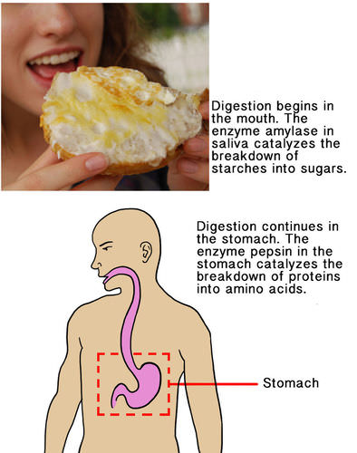
Chapter 2
Chemistry of Life
2.2 Biochemical Reactions
Learning Objectives for section 2.2:
Describe chemical reactions
State the role of energy in chemical reactions
Explain the importance of enzymes to living organisms.

Slide 2
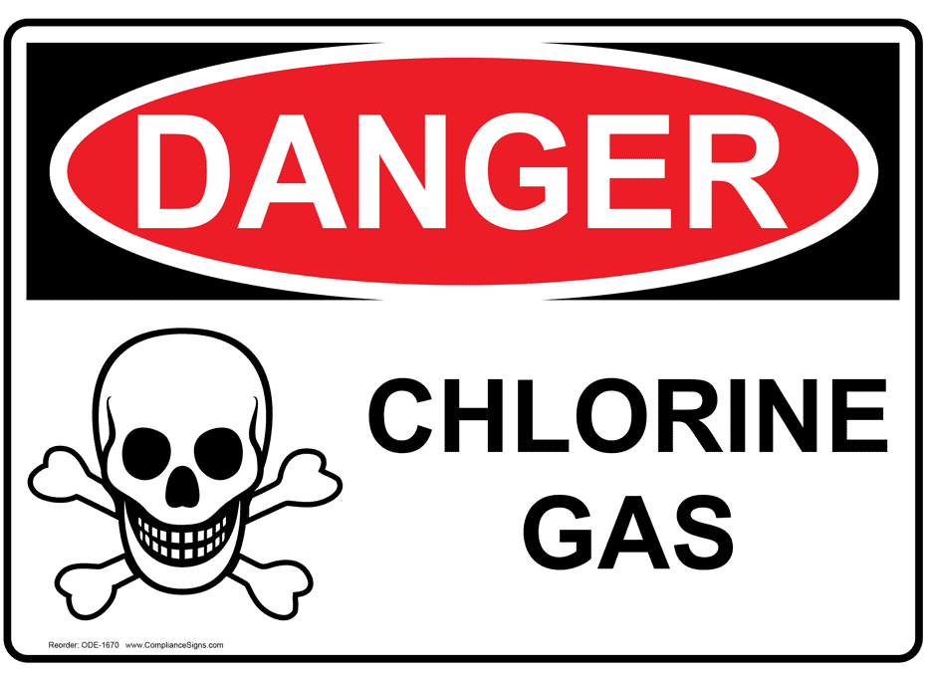
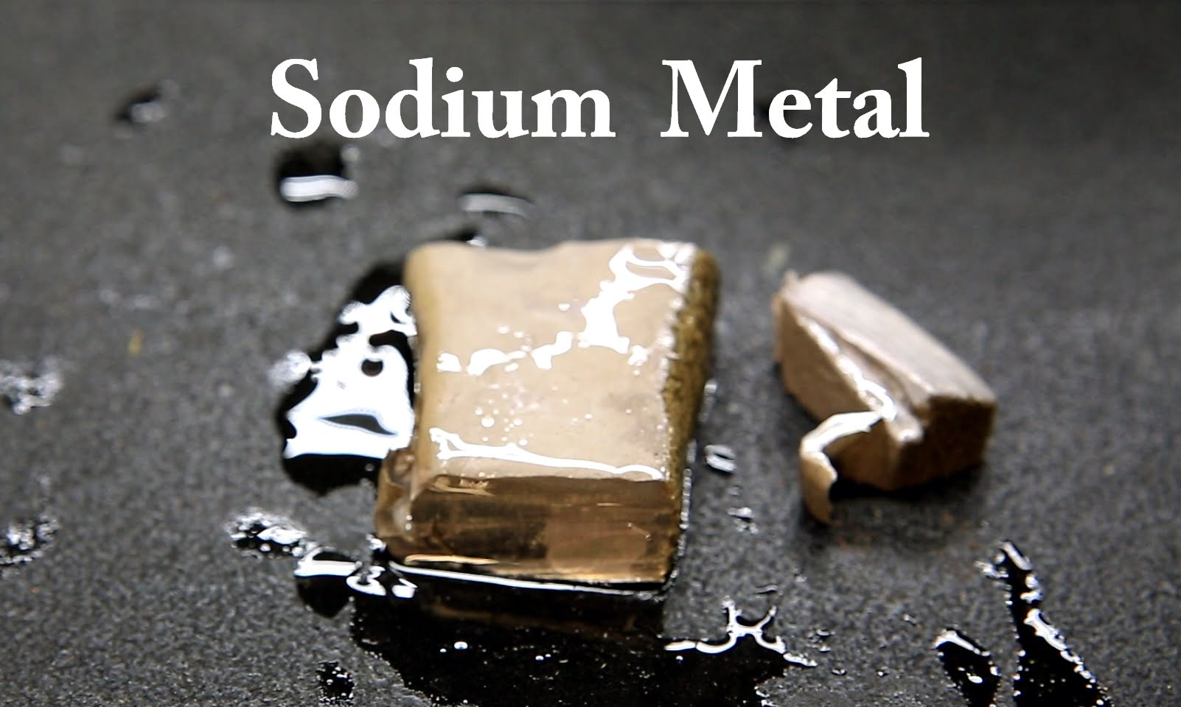
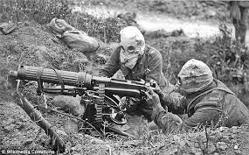
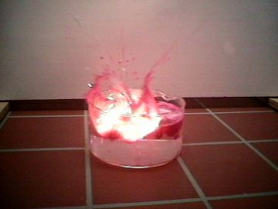
The element chlorine is a greenish poison.
Sodium metal reacts violently with water.
Would you eat them?
Well you eat them nearly everyday – as salt NaCl.

Slide 3
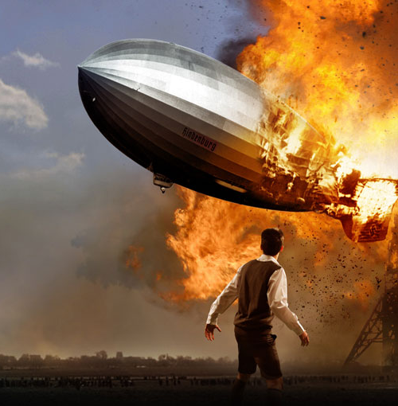
The element Hydrogen is highly flammable. All fires need oxygen to burn. Put those two elements together and they form water, which puts out fire.
Chemical reactions change some chemical substances into others.
Like hydrogen and oxygen forming water or sodium and chlorine forming salt.
Hindenburg disaster 1937.

Slide 4
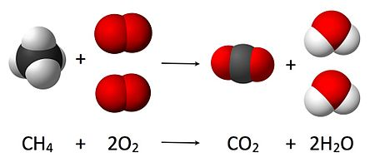
When a chemical reaction occurs, bonds are broken in the old substances, the reactants, and new bonds are formed in the new chemical substances, the products.
During a chemical reaction, the reactants are used up to make the product.
Reactants are CH₄ and 2O₂
Products are C0₂ and 2H₂O

Slide 5
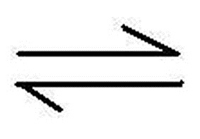
Chemical reactions can be represented by a chemical equation.
Reactants
Products
The arrow in the equation separates the reactants (left of the arrow) from the products (right of the arrow) and shows the direction in which the reaction is running.
If the arrow runs in both directions, it means the
reaction is running in the opposite direction at the
same time.

Slide 6
Conservation of Matter
The amount of each element does not change from reactants to products. The amounts stay the same. The elements are only rearranged, not created or destroyed.
Reactants:
1 Carbon
4 Hydrogen
4 Oxygen
Products:
1 Carbon
4 Hydrogen
4 Oxygen

Slide 7
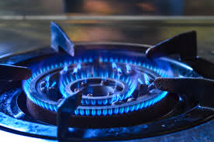
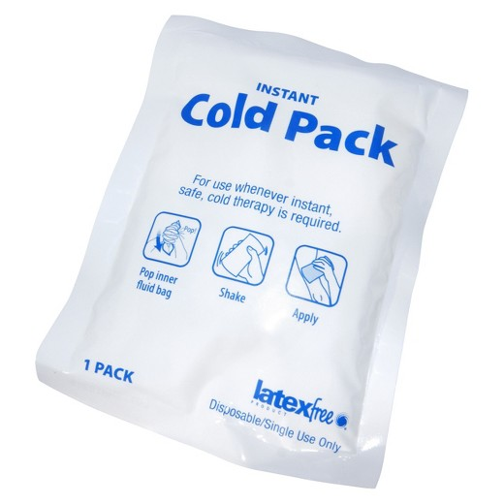
Chemical Reactions and Energy
Chemical reactions involve energy. Energy can either be released or absorbed by a chemical reaction.
Exothermic reactions – energy is release in the
form of heat. An example would be
burning methane gas to cook your
food.
Endothermic reactions – energy is absorbed. An
example is a cold pack you use to ice
an injury.

Slide 8
Chemical Reactions and Energy
All chemical reactions need energy to get started. This beginning energy is known as Activation Energy.
In order for molecules to react, they must bump into each other. Activation energy is needed to give the molecules a “shove” to get the moving.

Slide 9
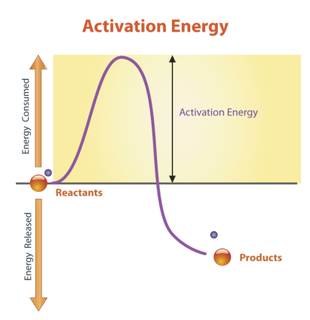
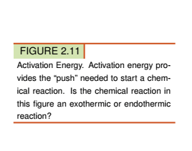
Endothermic or Exothermic?

Slide 10
Biochemical Reactions and Enzymes
Biochemical reactions are chemical reactions that happen inside the cells of living things (organisms).
They basically fall into two categories:
1. Catabolic reactions – reactions that break down large molecules into smaller molecules and release energy in the form of heat. They are exothermic.
2. Anabolic reactions – reactions that build bigger molecules from smaller molecules which requires energy. They are endothermic.

Slide 11
Biochemical Reactions and Enzymes
Biochemical reactions in organisms need help to get started.
Living things get help from enzymes which are proteins that lower the amount of activation energy needed to get reactions going.
There are around 75,000 identified enzymes in the human body. Each enzyme works only on a specific type of molecule called a substrate.

Slide 12
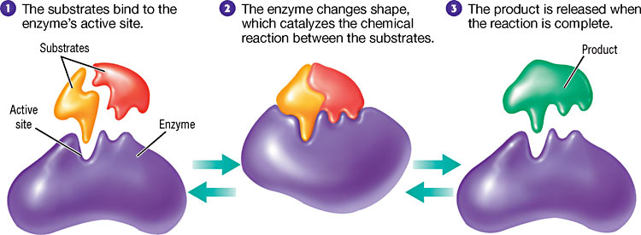
Biochemical Reactions and Enzymes
Each enzyme has a particular shape that “fits” on one particular substrate at an active site.
If the protein loses its shape, it no longer has the proper active site and that particular reaction will not take place.
Protein shapes are sensitive to high temperatures and to pH imbalances.

Slide 13
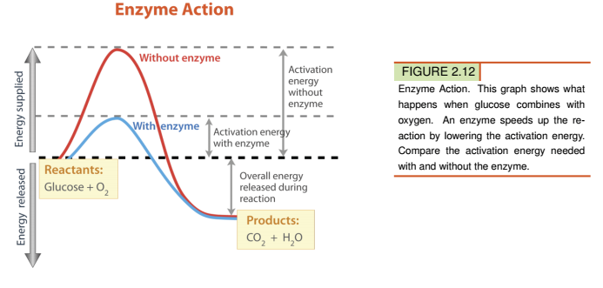
Biochemical Reactions and Enzyme Action

Slide 14
Summary:
A chemical reaction is a process that changes some chemical substances into others. It involves breaking and reforming chemical bonds. They follow the Law of Conservation of Matter.
Some chemical reactions release energy (exothermic) while others absorb energy (endothermic). All chemical reactions require activation energy to get started.
Enzymes are needed to speed up biochemical reactions in organisms. They work by binding with a substrate at an active site and lowering activation energy needed to run the biochemical reaction.

