Slide 1
? ? ? ? ?
What words does an author use to indicate they are using a particular text structure in their writing?

Slide 2


TEXT STRUCTURE
I understand!
Text
Signal Words
THE METHOD USED BY AUTHORS TO ORGANIZE INFORMATION
Standard: 7B33 Identify, compare, explain, interpret, describe and analyze
how text organization clarifies meaning of non-fiction text.

Slide 3
WE NEED TO RECONGNIZE TEXT STRUCTURE!
  Noting the transition clues in a paragraph is often the key to solving the mystery of its organization. Transition clues help you see the relationships between ideas.
  As a reading detective, you must use the clues that you can find to try to deduce the main idea by studying the supporting details.
  There are hundreds of different clue words.

Slide 4
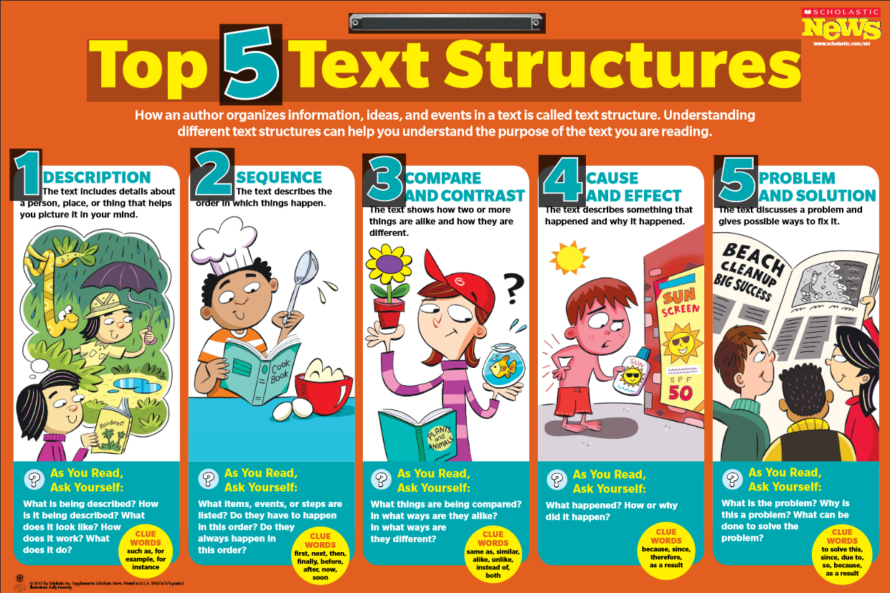
Sneak Preview:

Slide 5
STRUCTURE (ORGANIZATION)
FICTION | NON-FICTION
STORY ELEMENTS | DESCRIPTION
CHARACTERS | SEQUENCE
SETTING | COMPARE/CONTRAST
PROBLEM | CAUSE/EFFECT
PLOT | PROBLEM/SOLUTION
Sometimes an author will use several text structures in one piece.
For example, your social studies book may be written in chronological order (in order of years) but may also contain a section that explains
cause and effect.
Notice the job the transition clue is doing to help you understand what you read.

Slide 6
Text Structure Book
You will need 4 pieces of paper.
Create a staggered group of papers –
place the 2nd layer about ¾” above the
bottom layer, 3rd layer, about ¾” above
2nd layer, last layer ¾” above that; then fold down
so top paper is ¾” above the last.
Write TEXT STRUCTURES topmost flap.
Flap #2 – Descriptive Text Structure
Staple onto colored notebook paper

Slide 7
DESCRIPTION
Descriptive text features a detailed description of something to give the reader a mental picture.
SIGNAL WORDS
QUESTIONS TO ASK YOURSELF:
For example
Most important
In front
Beside
Near
Next to
On top of
What signal words are being used?
What is being described?
Which detail is most important?
Signal Words: Questions
Xxxxxxxx xxxxxxxx
Xxxxxxxx xxxxxxx
Text Structure
Description
http://www.slideshare.net/elkissn/teaching-text-structure

Slide 8
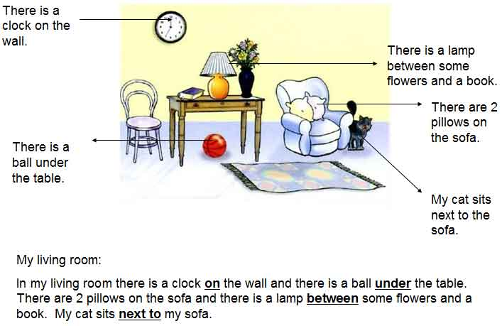
Locate description signal words.

Slide 9

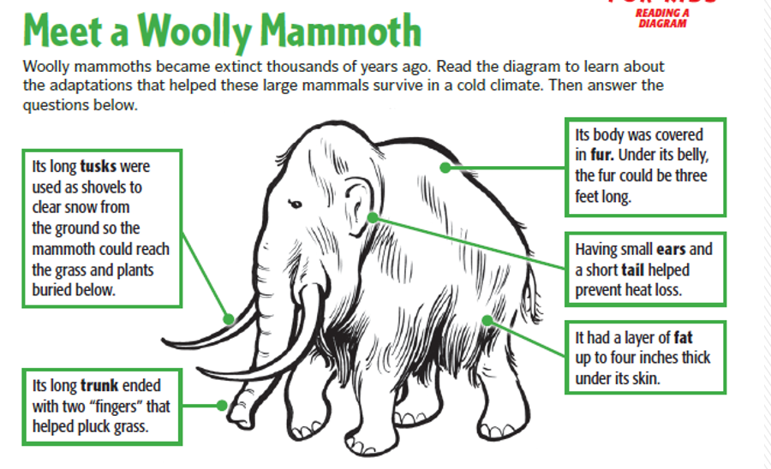
Before becoming extinct, the Wooly Mammoth was able to survive in a cold climate for several reasons. It had long tusks that it could use as shovels to clear snow from the ground to reach grass and plants buried below. Its trunk ended with two “fingers” that enabled it to pluck grass. Its body was covered in fur. In fact, its belly fur could be three fee long. To prevent heat loss, its ears and tail were small. Finally, a nearly four inch layer of fat under its skin helped to keep it warm.

Slide 10
Look for the descriptions
"..... in my walk I Killed a Buck Goat of this Country, about the height of the Grown Deer, its body Shorter the Horns which is not very hard and forks 2/3 up one prong Short the other round & Sharp arched, and is immediately above its Eyes the Color is a light gray with black behind its ears down its neck, and its face white round its neck, its Sides and rump round its tail which is Short & white: Very actively made, has only a pair of hoofs to each foot, his brains on the back of his head, his Nostrils large, his eyes like a Sheep he is more like the Antelope or Gazelle of Africa than any other Species of Goat." Lewis and Clark As Naturalists
What descriptive words were used in the passage?
What is being described?
Buck Goat
http://www.homepages.dsu.edu/venekaml/Lewis%20and%20Clark/EXPOSITORY%20TEXT%20STRUCTURES.htm

Slide 11
Organizing the Information
"..... in my walk I Killed a Buck Goat of this Country, about the height of the Grown Deer, its body Shorter the Horns which is not very hard and forks 2/3 up one prong Short the other round & Sharp arched, and is immediately above its Eyes the Color is a light gray with black behind its ears down its neck, and its face white round its neck, its Sides and rump round its tail which is Short & white: Very actively made, has only a pair of hoofs to each foot, his brains on the back of his head, his Nostrils large, his eyes like a Sheep he is more like the Antelope or Gazelle of Africa than any other Species of Goat."
Large nostrils
Eyes like a sheep
Height of grown deer
Body shorter
Buck Goat
Hoof –pair on each foot
Light gray with black behind its ears and down its neck
White face, round its neck, sides, tail (short)
Horns:
Not very hard
Forks
2/3 up one prong is short, the other round and sharp

Slide 12

Freedom's Journal By Brenda B. Covert
1
Freedom's Journal was a weekly
newspaper. It was the first American
newspaper owned and created by blacks! It
was formed on March 16, 1827, in New York
City. This seems fitting, since slavery was
done away with in New York state that same
year. The paper was four pages long. The
editors ran articles on current events. They
also ran editorials or opinion pieces. The
paper printed the black viewpoint; this was
missing from papers run by whites. The paper
covered issues such as slavery, the right to
vote, and returning free blacks to Africa.
These issues were important to blacks. The editors wanted to educate
their readers. They shared both local and national news as well as
news from other parts of the world. Freedom's Journal only lasted
for two years. However, that wasn't the end of black-owned and
operated newspapers. Others were formed around the country. When
the Civil War broke out, there were more than 40 papers that could
have reported the news from a black point of view.
2
3
4
How many details can you find in the reading?
5
6
7
8
9
10
11
12

Slide 13
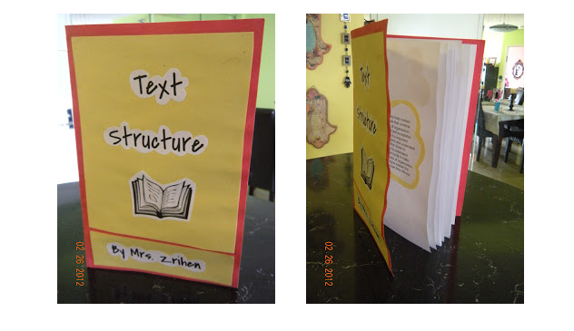
Demonstrate your knowledge!
Locate a descriptive article in the provided materials, and begin your Text Structure Book.
Remember, signal words include:
  For example
  Most important
  In front of
  Beside
  Near
  Next to
  On top of
Be able to answer the following questions:
  What is being described?
  Which detail is most important?
  How do all of the details fit together?

