Slide 1
SEQUENCE TEXT
Organized from one point in time to another.

Slide 2
Signal Words Questions to ask:
Text Structure
Description
Sequence
Sequence

Slide 3
This structure is organized from one point in time to another.
SIGNAL WORDS
QUESTIONS TO ASK YOURSELF:
What events or steps are listed?
Do they have to happen in that order?
Do they always happen in this order?
What is the time span from the first event to the last?
First
Second
Next
Later
Finally
Now
Soon
Then
Before
After
Following
Times
Dates

Slide 4
Signal Words Questions to ask:
First, second, now, next, then, after, before, later, finally, dates, times
What events/steps are listed?
Do they have to happen in that order?
What is the time span from the first event to the last?
Text Structure
Descriptive
Sequence
Sequence

Slide 5
Graphic Organizer
Timeline
Make hash marks for the time periods.

Slide 6
Using a Timeline
Want to be healthier? There are several ways to become healthier. First, get rid of “worthless” calories in your diet. Soft drinks, candy bars, and other snack foods give you lots of calories with no nutrition. Next, eliminate as much of the fat as you can from your meals. Bake or broil; don’t fry your food. Last, get more exercise. Instead of taking the elevator, walk up the stairs. Play with your friends or take a hike instead of watching television.
First
Next
Last
Get rid of
empty calories
Eliminate
Excess fat
Exercise more

Slide 7
Outline

Slide 8
Using an Outline
Ronald Reagan did many things before he became president of the United States. In high school and college, he was a football player. After graduation, he became a radio sportscaster. Five years later, he signed his first movie contract, and over the next few decades made many movies. During World War II, Reagan was a captain in the U.S. Air Force. In 1966, he ran for governor of California and won.
Can you place this information into an outline?

Slide 9
Outline
Ronald Reagan’s life before becoming President
In high school and college
Football player
After graduation
Radio sportscaster
Five years later
Signed his first movie contract
Next few decades
Made many movies
During World War II
U. S. Air Force Captain
1966
Became Governor of California

Slide 10
Understanding Sequence
How did plants and animals that died long ago turn into fossils? First, their remains sank to the bottom of a body of water. Next these remains were slowly buried by layers of mud and sand. After a long time had passed, the lower layers hardened into rock. Meanwhile, the remains inside them had also hardened to form fossils. Finally, water and wind eroded the rock, and the fossils inside were exposed on the surface.
Remains sink to bottom of water
Remains slowly buried
Layers hardened into rock
Remains hardened forming fossils
Erosion exposed the fossils

Slide 11
First Event
Next Event
Final Event
Plants on the Trail with Lewis and Clark, Dorothy Hinshaw Patent p.22-23
The quality of Lewis's surviving plant specimens is amazing, considering their age and the difficult conditions on the trail. Preparing and preserving plants is a time-consuming and demanding process. A specimen has to be spread out properly, then pressed between two sheets of blotting paper. The paper soaks up the moisture from the specimen, drying it out. The specimen must be removed, aired, and placed between fresh sheets until it is completely dry, so it won't rot. There were times when Lewis had to deal with a large number of plants all at once. While he stayed with the Nez Prece Indians, for example, he had between thirty and fifty specimens to tend to every day.
1
2
3
4
5
http://www.homepages.dsu.edu/venekaml/Lewis%20and%20Clark/EXPOSITORY%20TEXT%20STRUCTURES.htm

Slide 12
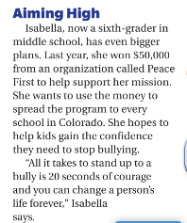
Signal Words Questions to ask:
First, second, now, next, then, after, before, later, finally, dates, times
What events/steps are listed?
Do they have to happen in that order?
What is the time span from the first event to the last?
Text Structure
Sequence
Sequence

Slide 13
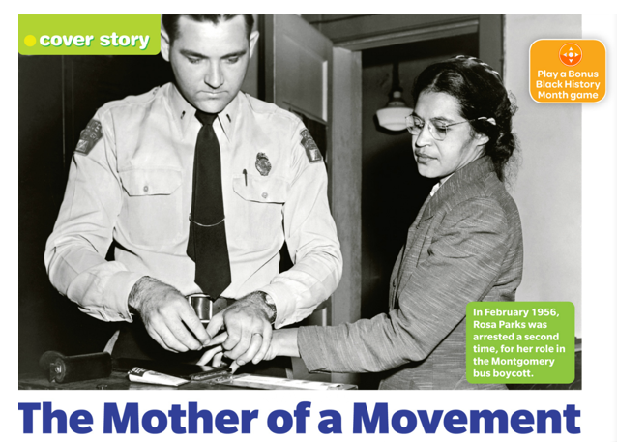
Practice what you learned!

Slide 14
Complete your Sequence Page
Place the heading at the top of the page:
Sequence Text Feature
Attach the passage
that contains
a sequence of events
HERE
Signal Words:

