Slide 1
Welcome, Families!
Dr. David W. Kistler
Elementary School

Slide 2
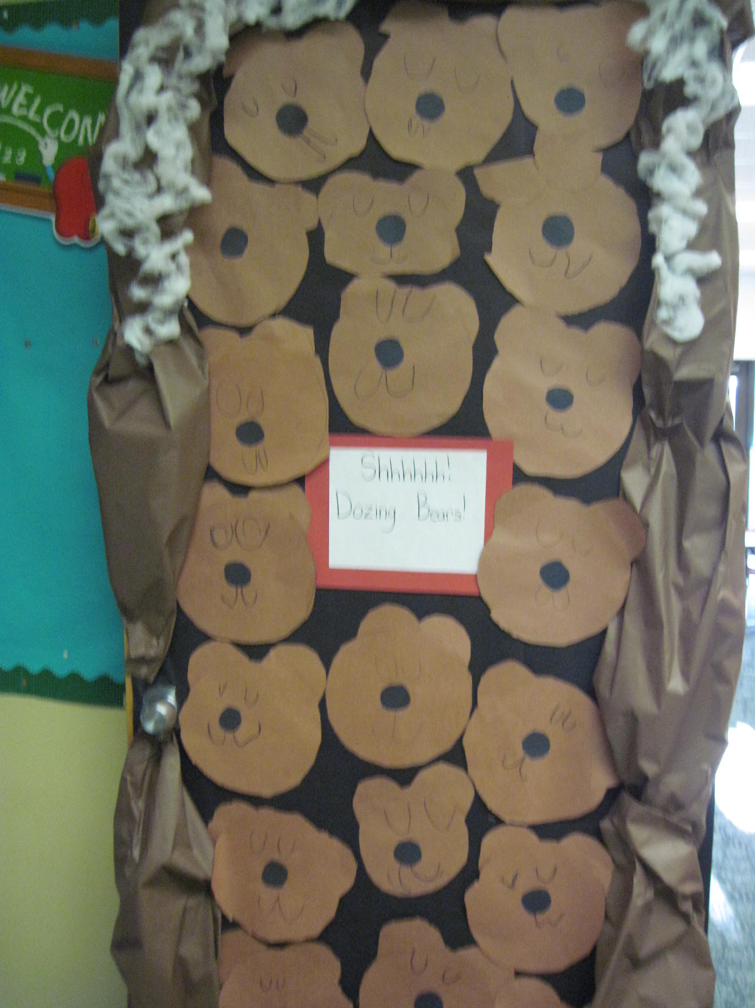
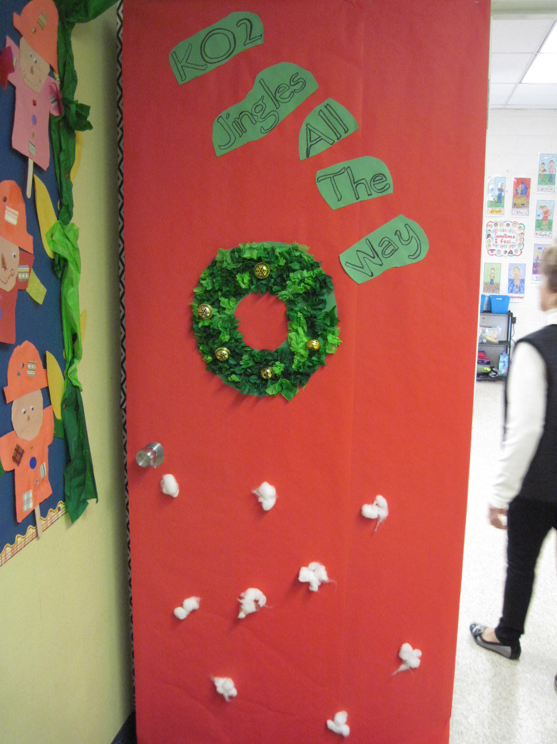
Kindergarten Classroom Doors
K-1 Mrs. Barber
K-2 Mrs. Hine

Slide 3
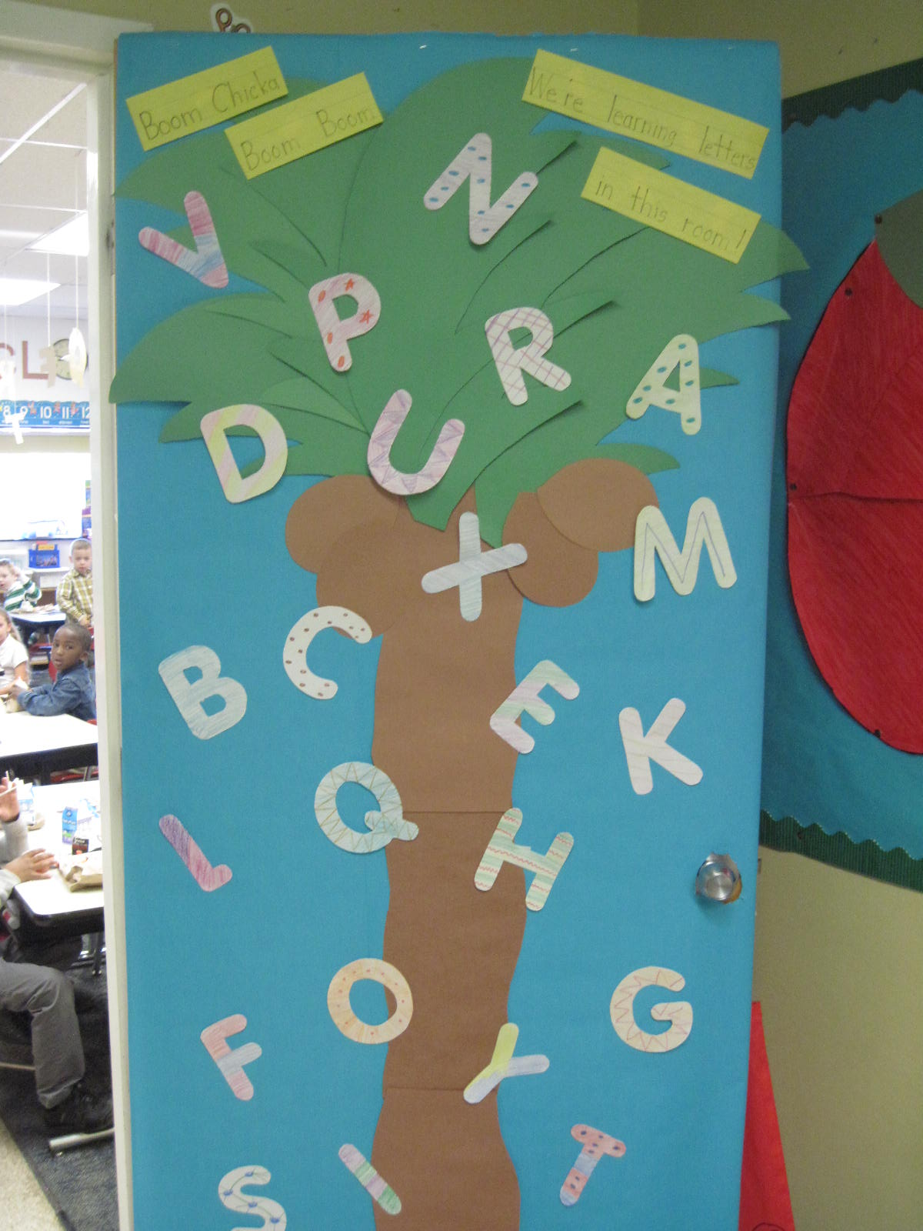
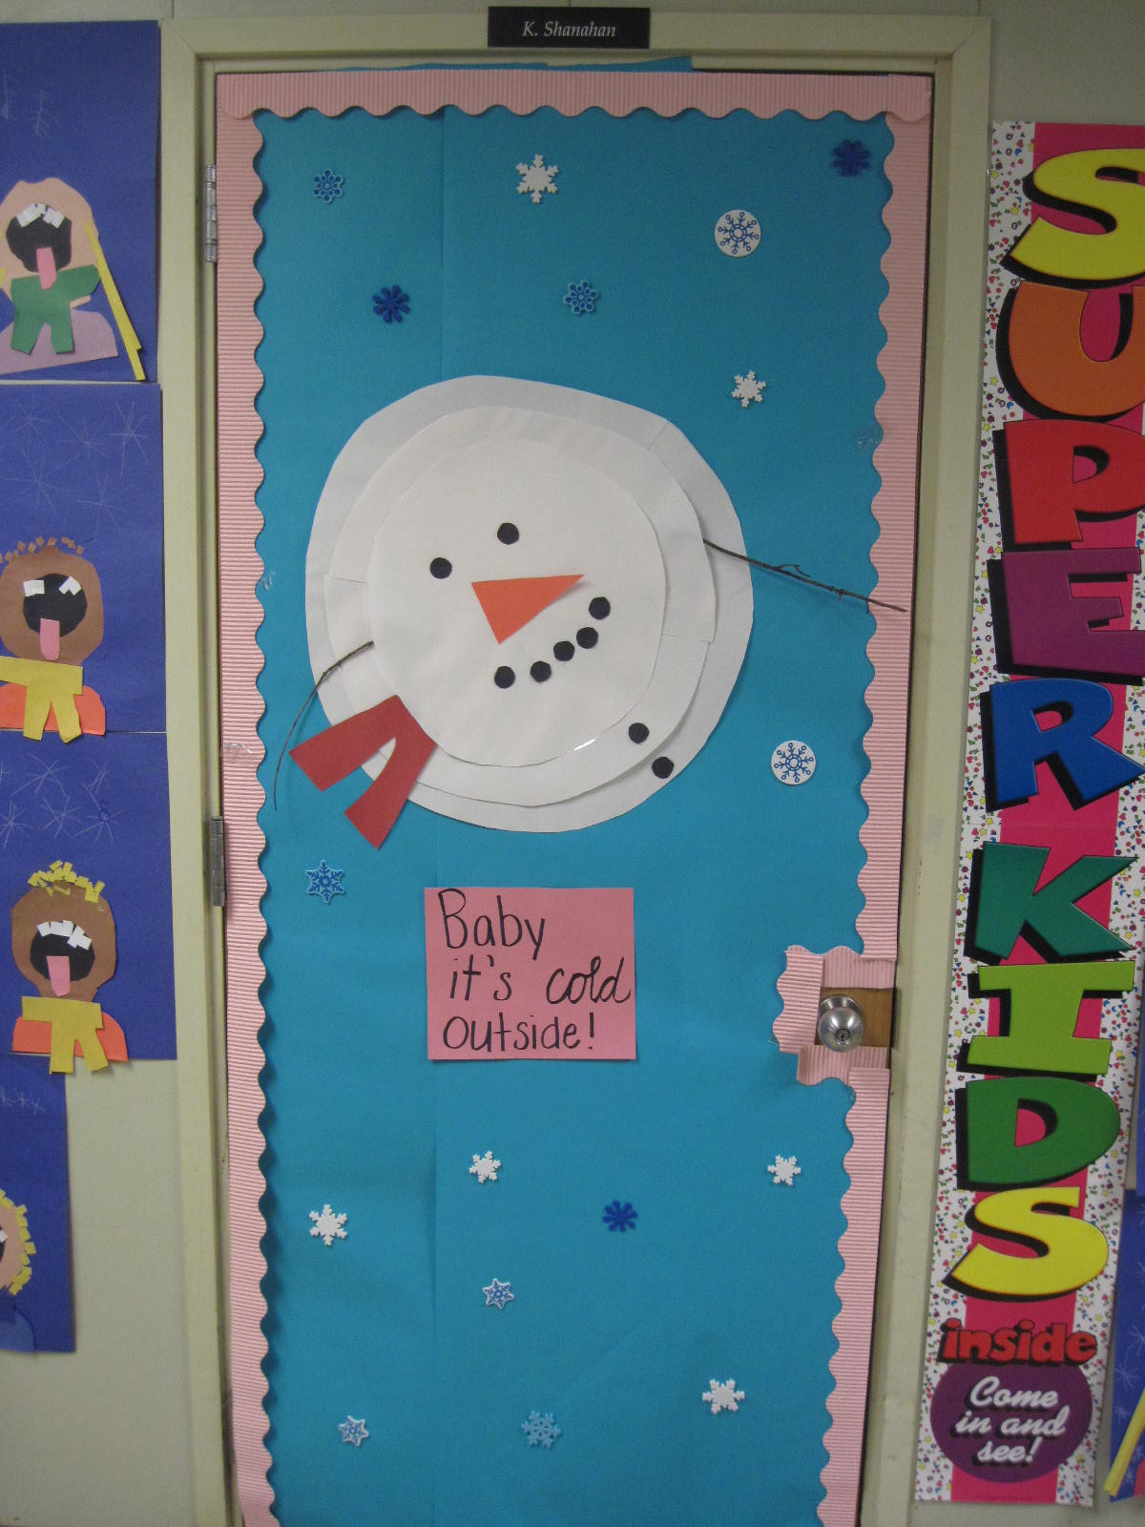
Kindergarten Classroom Doors
K-3 Mrs. Lynch
K-4 Ms. Shanahan

Slide 4
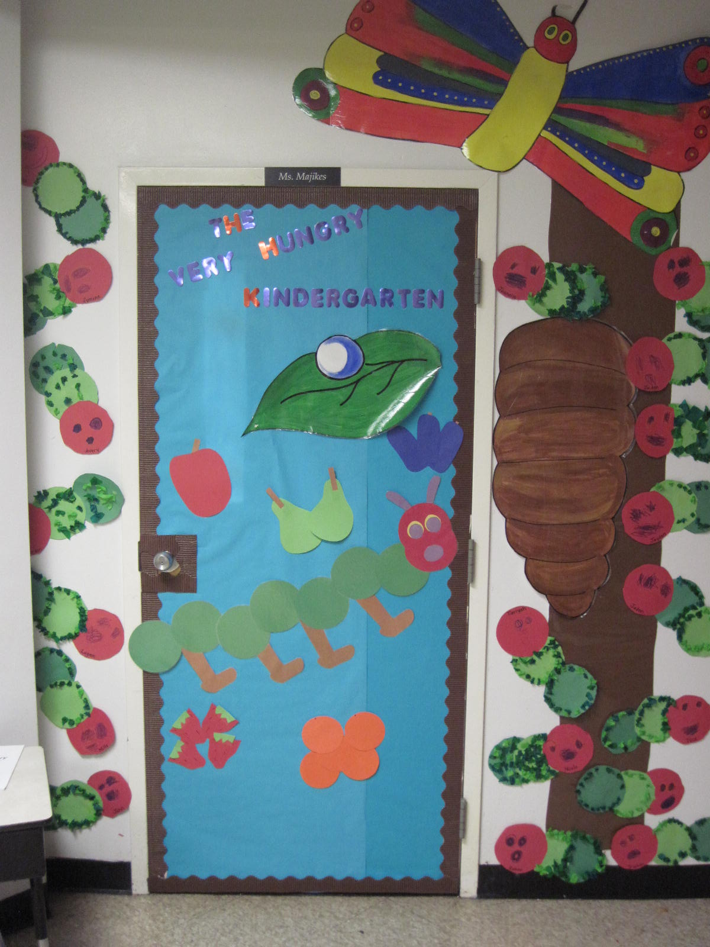
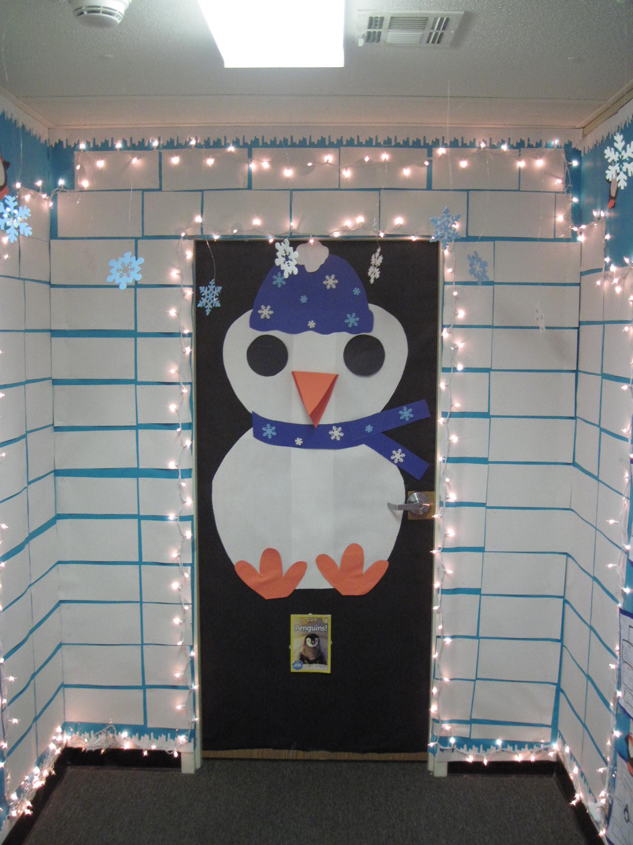
Kindergarten Classroom Doors
K-5 Ms. Majikes
K-6 Mrs. Kroll

Slide 5
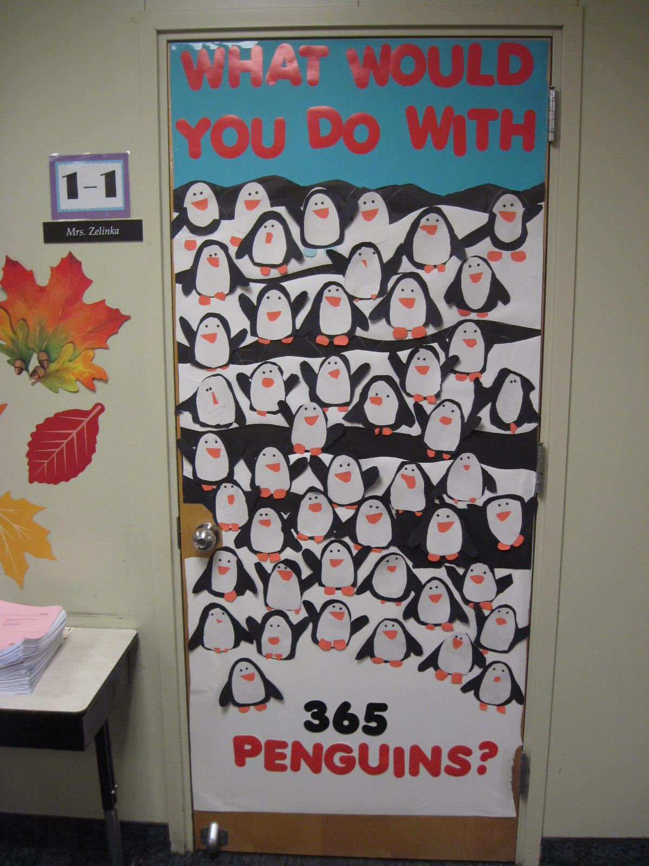
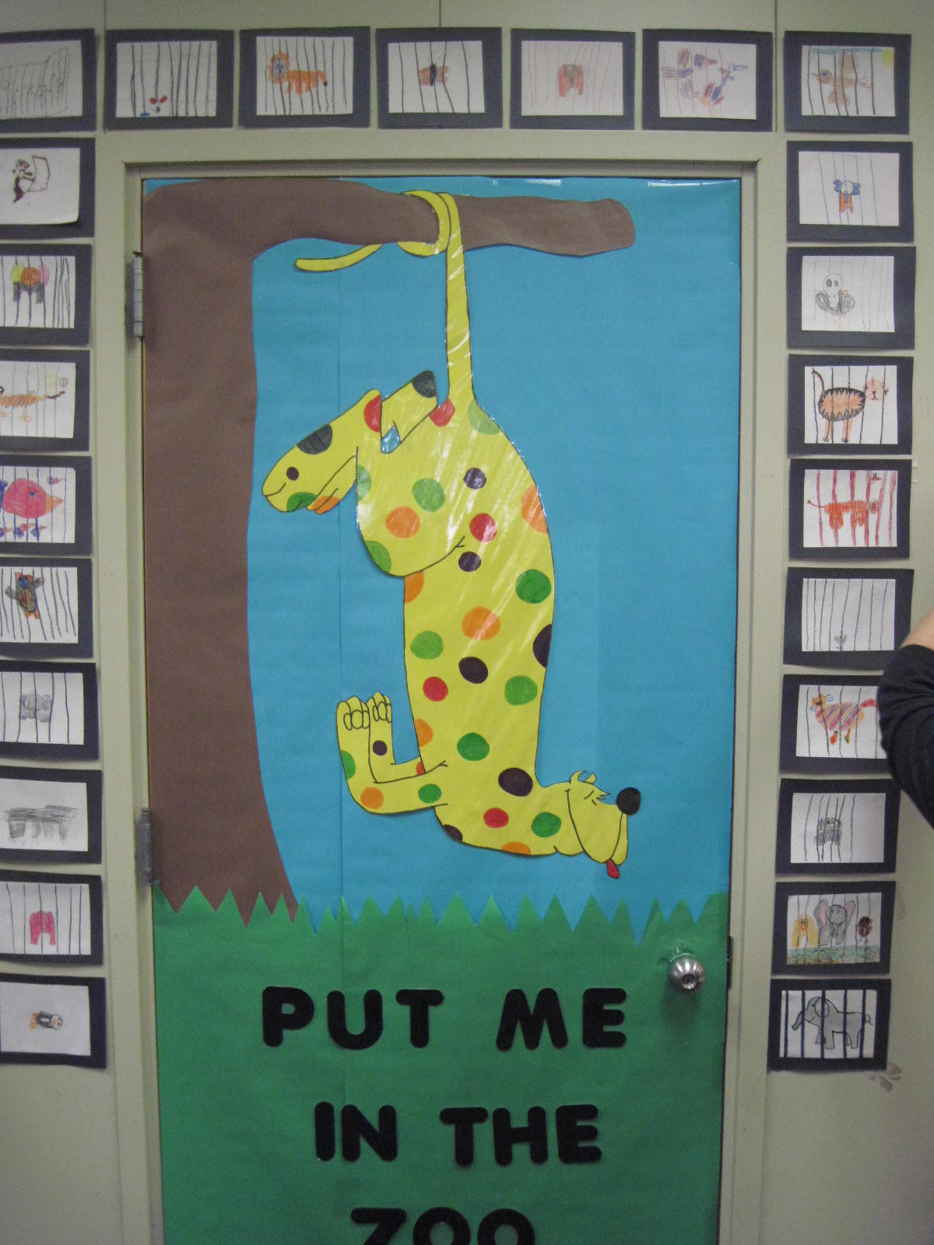
1st Grade Classroom Doors
1-1 Mrs. Zelinka
1-2 Mrs. Chase

Slide 6
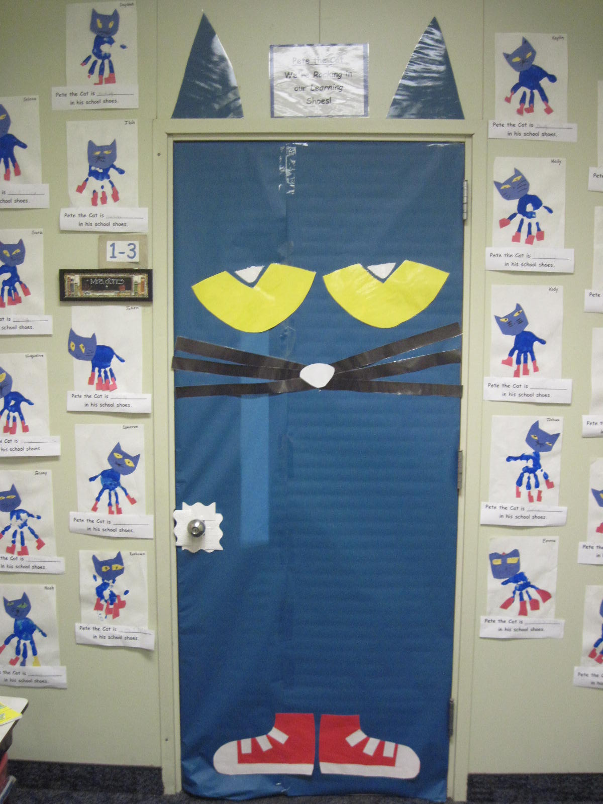
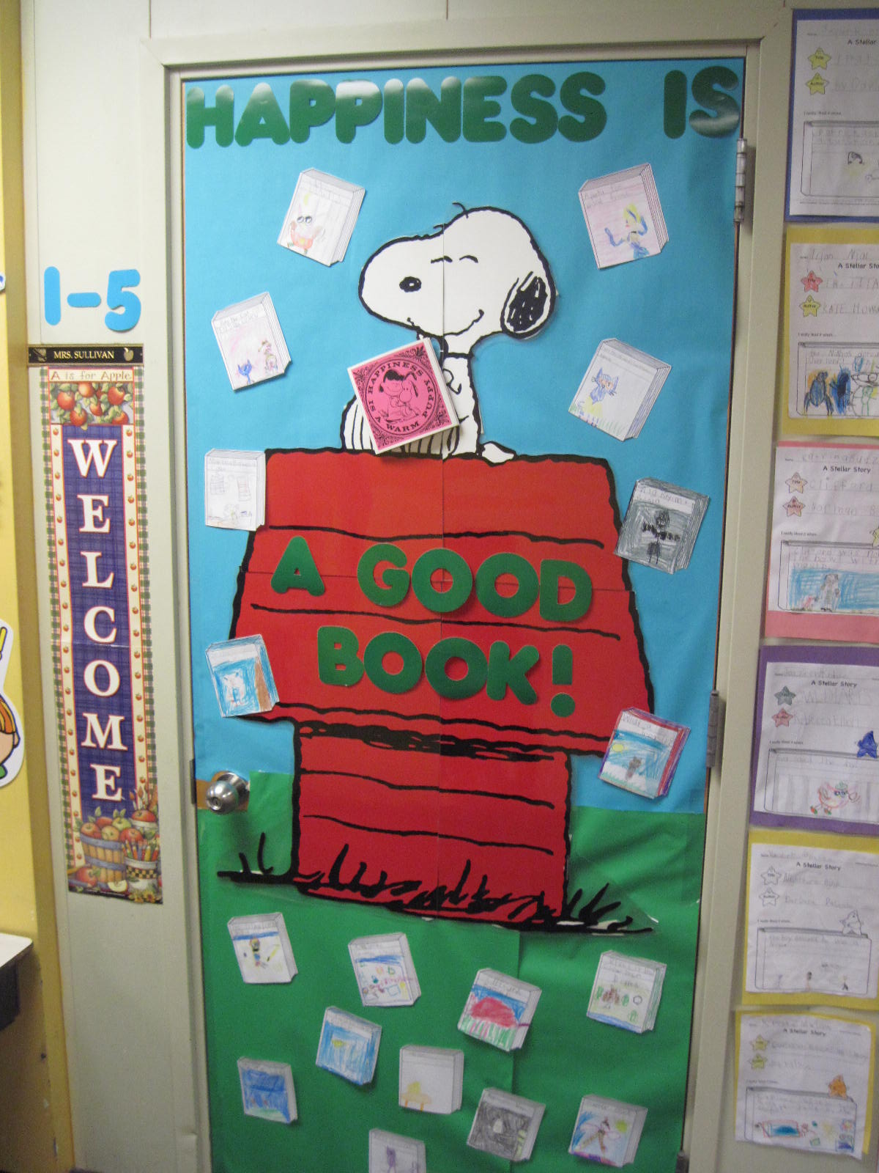
1st Grade Classroom Doors
1-3 Mrs. Jones
1-5 Mrs. Sullivan

Slide 7
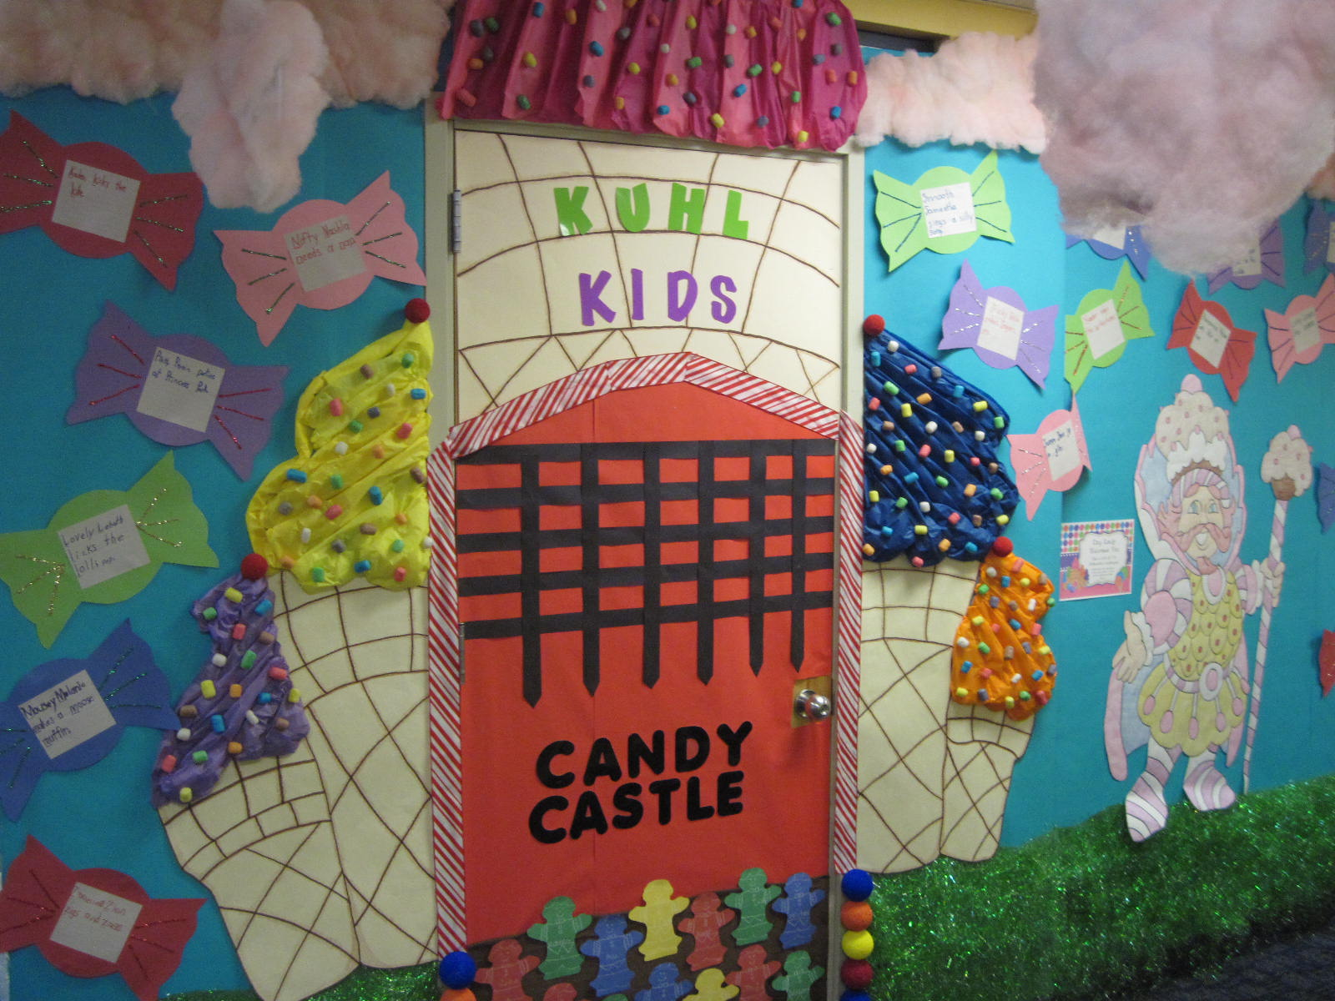
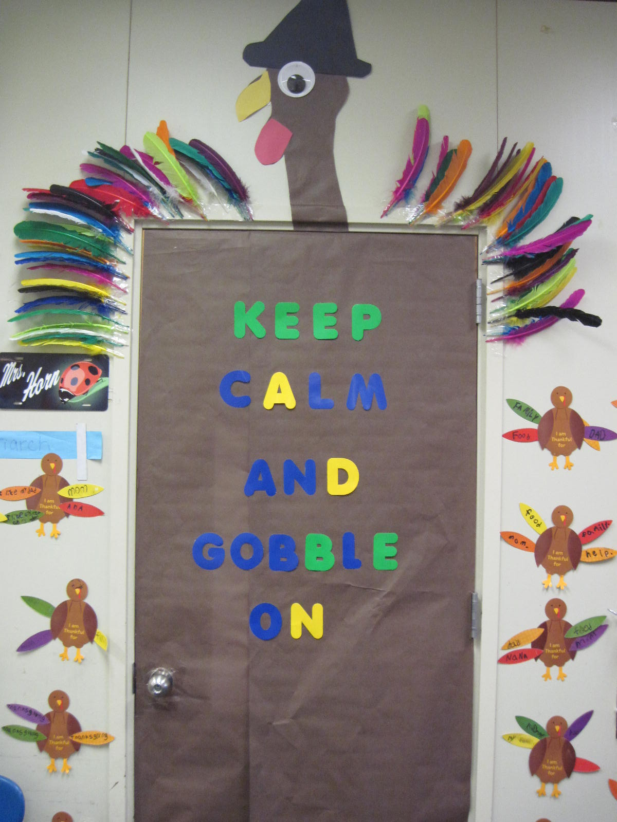
1st Grade Classroom Doors
1-6 Mrs. Horn
1-4 Mrs. Augello Kuhl

Slide 8
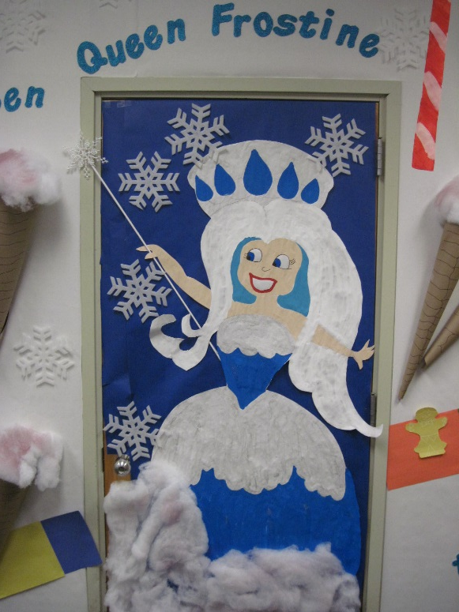
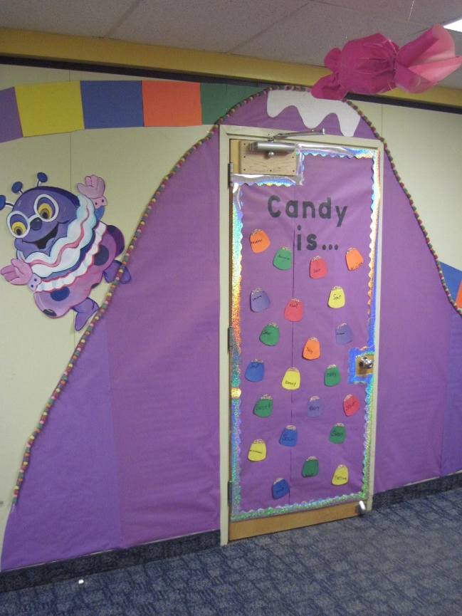
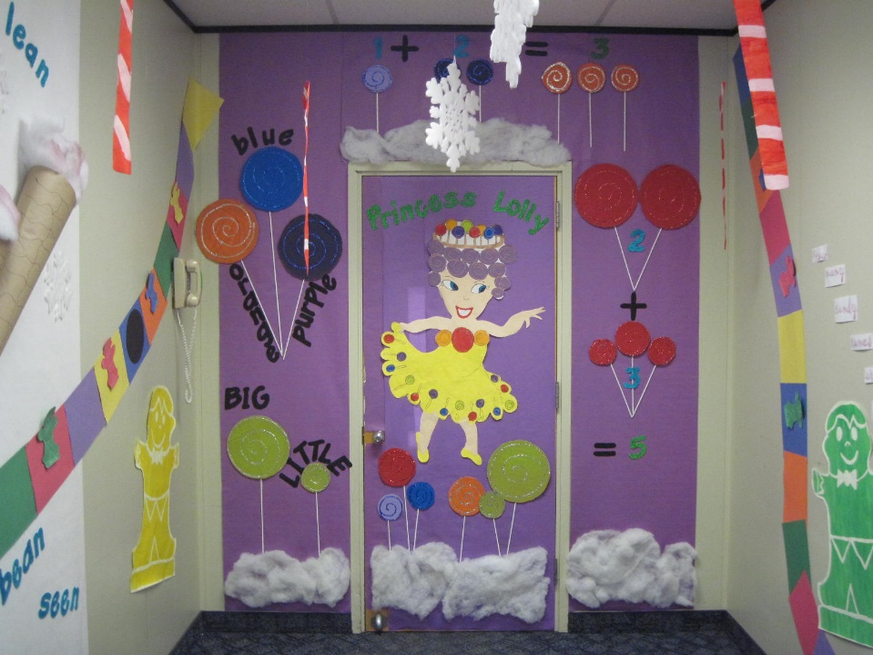
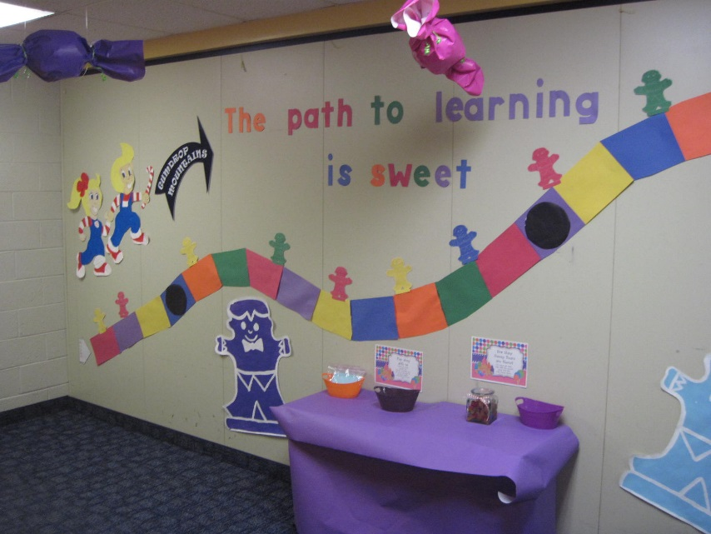
L.I.U.- E. SUPPORT- Section 1-4

Slide 9
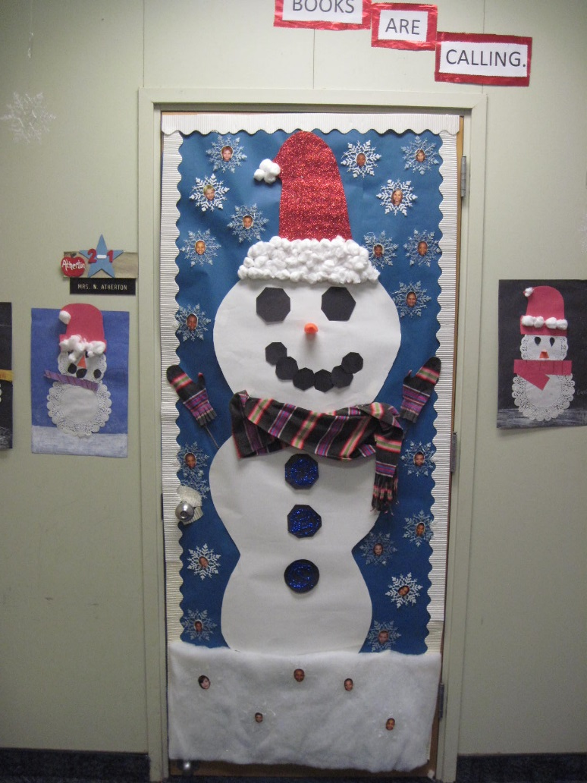
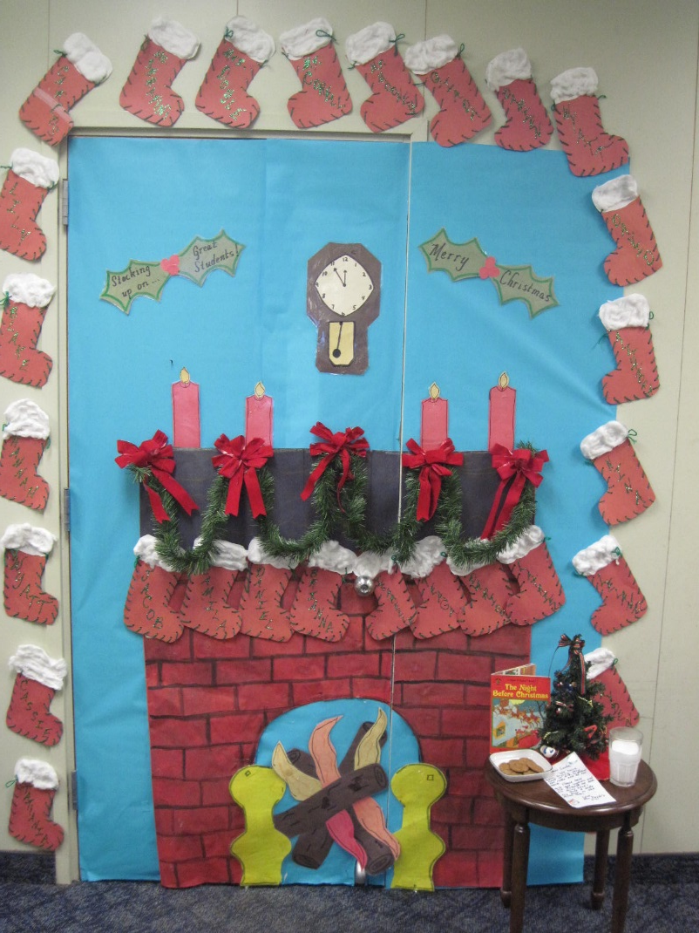
2nd Grade Classroom Doors
2-1 Mrs. Atherton
2-2 Mrs. Doyle

Slide 10
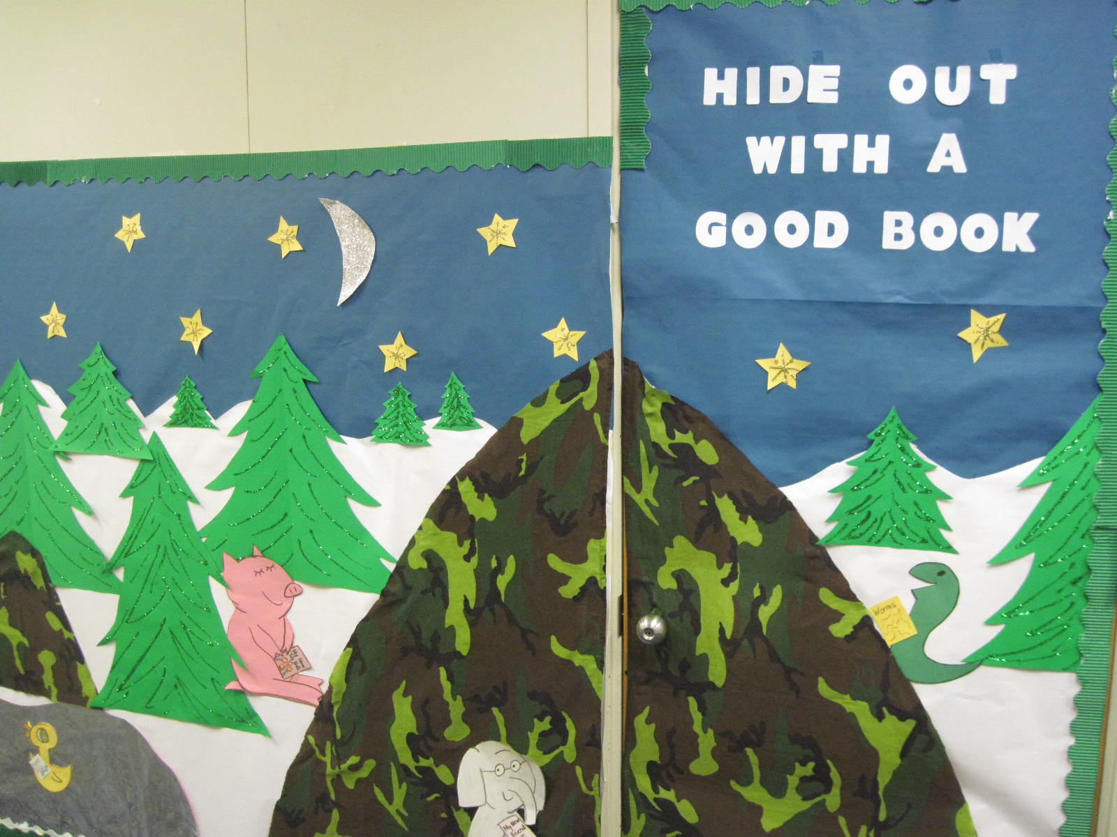
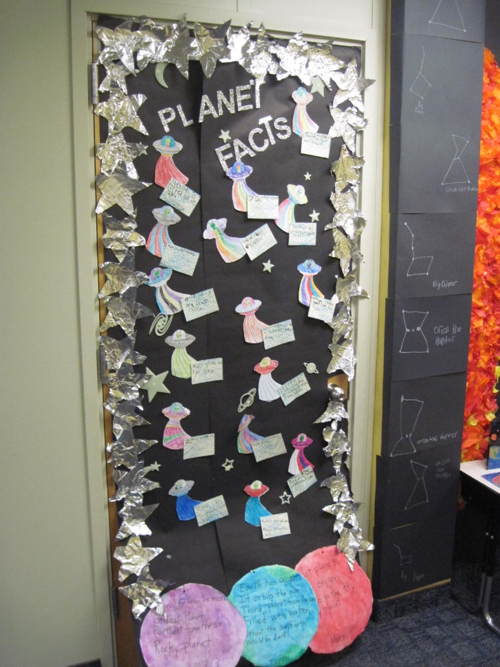
2nd Grade Classroom Doors
2-3 Mr. Yanora
2-4 Mrs. Canavan

Slide 11
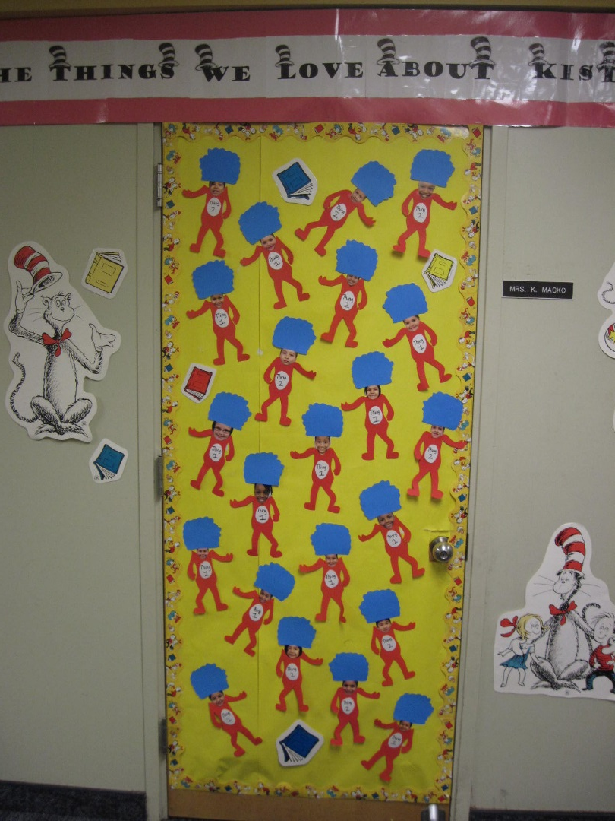
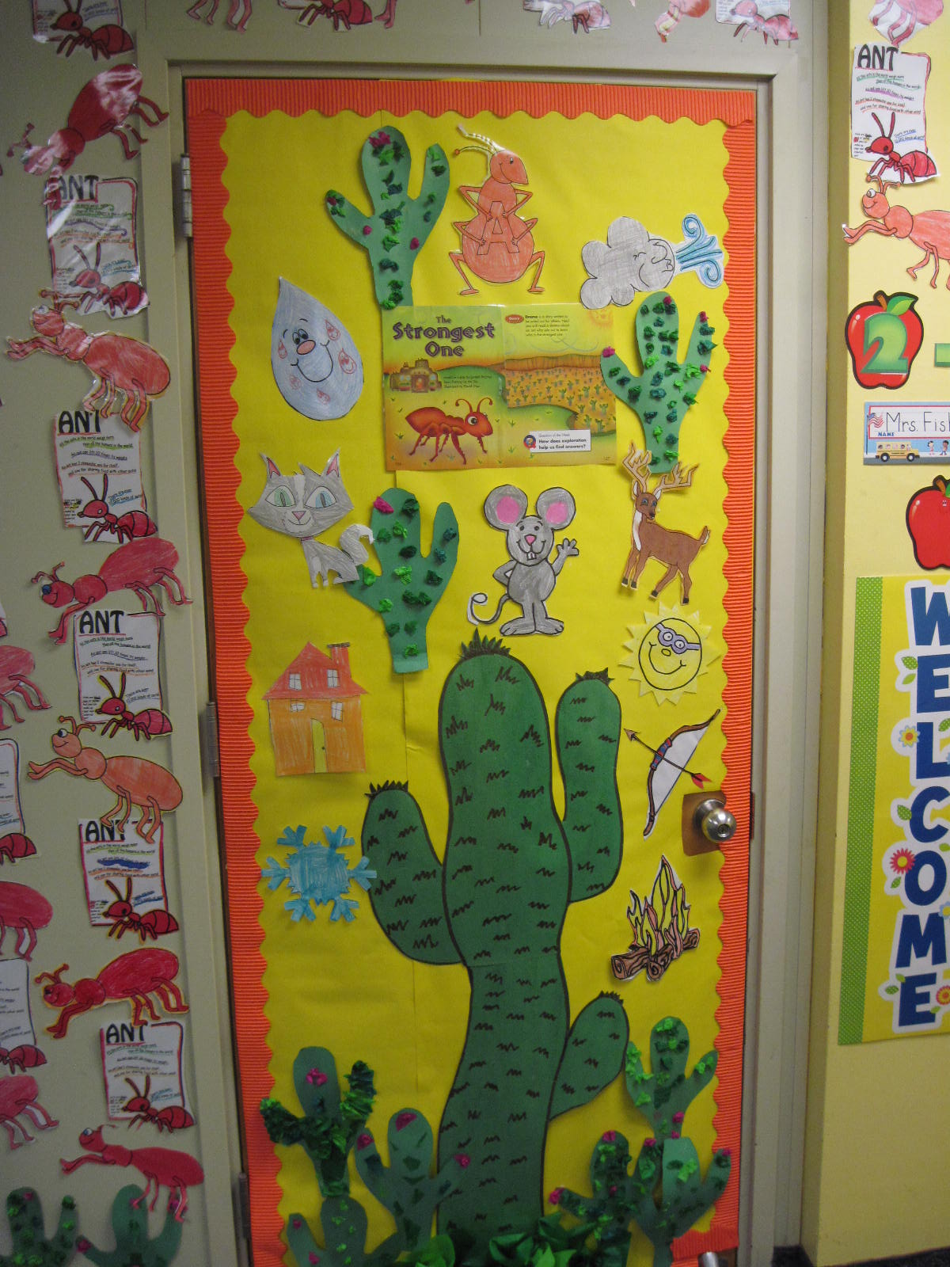
2nd Grade Classroom Doors
2-5 Mrs. Macko
2-6 Mrs. Fisher

Slide 12
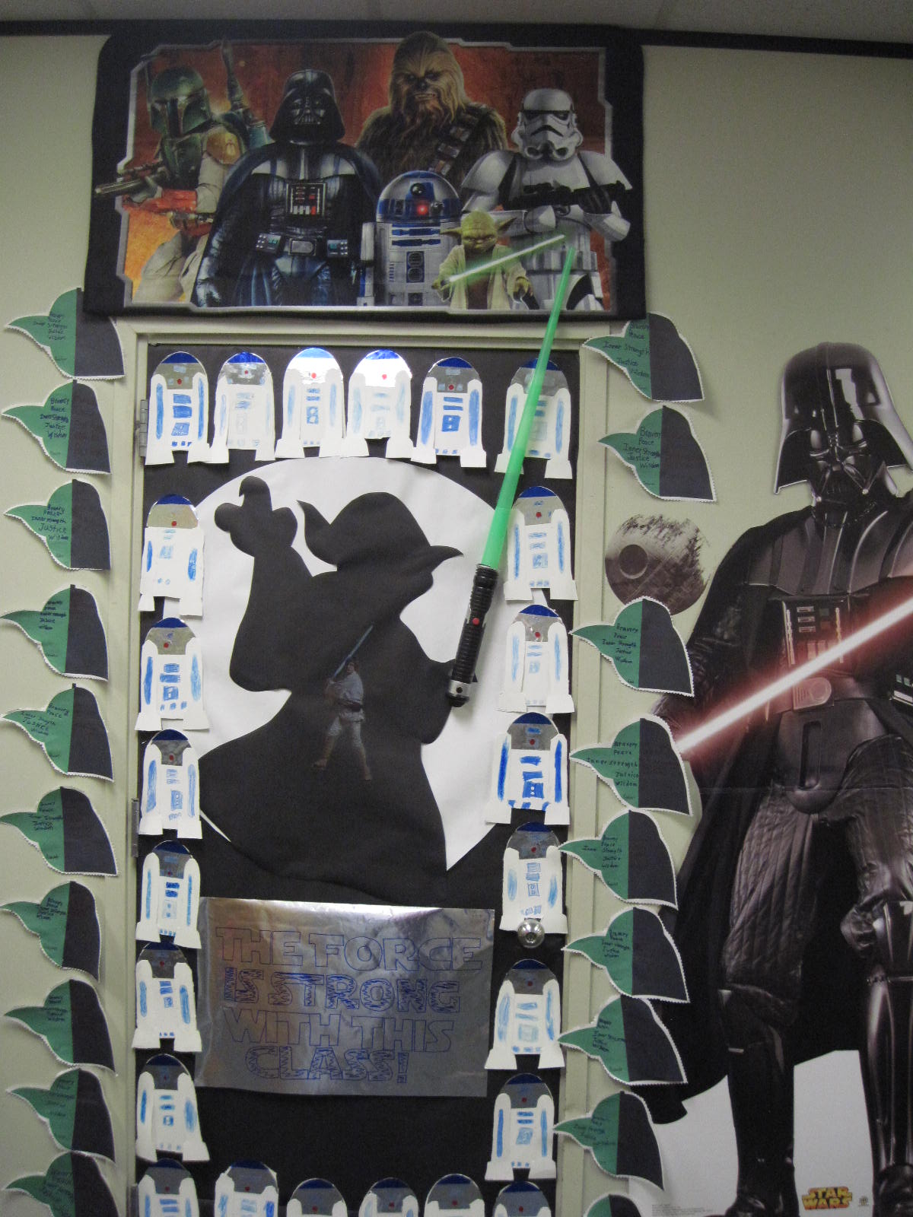
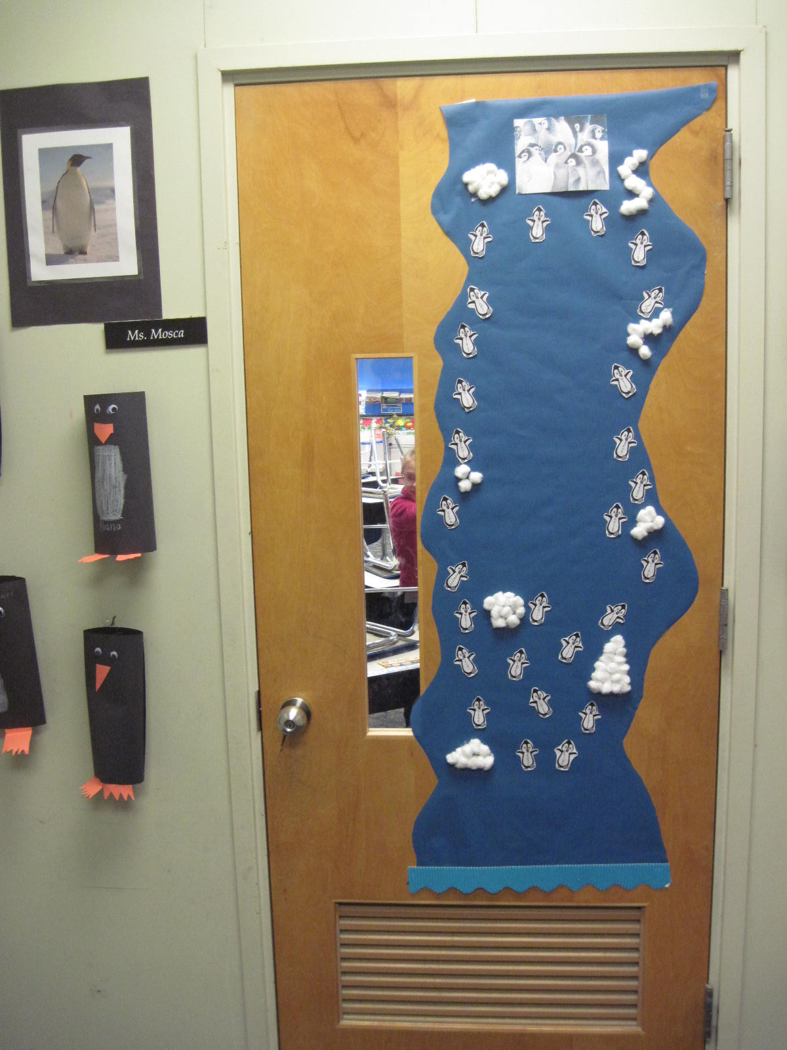
3rd Grade Classroom Doors
3-1 Mrs. Gubbiotti
3-2 Ms. Mosca

Slide 13
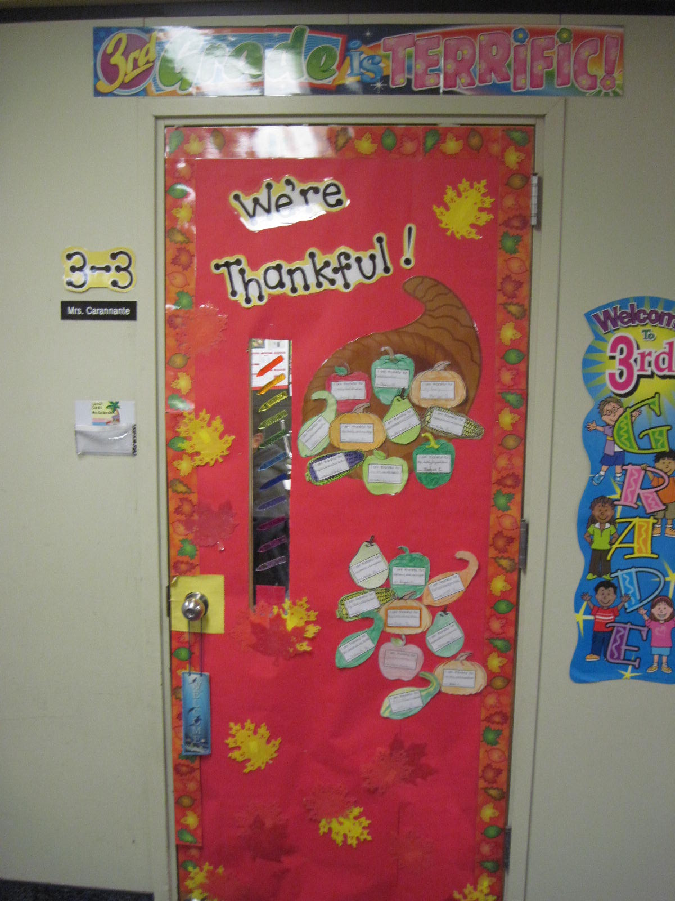
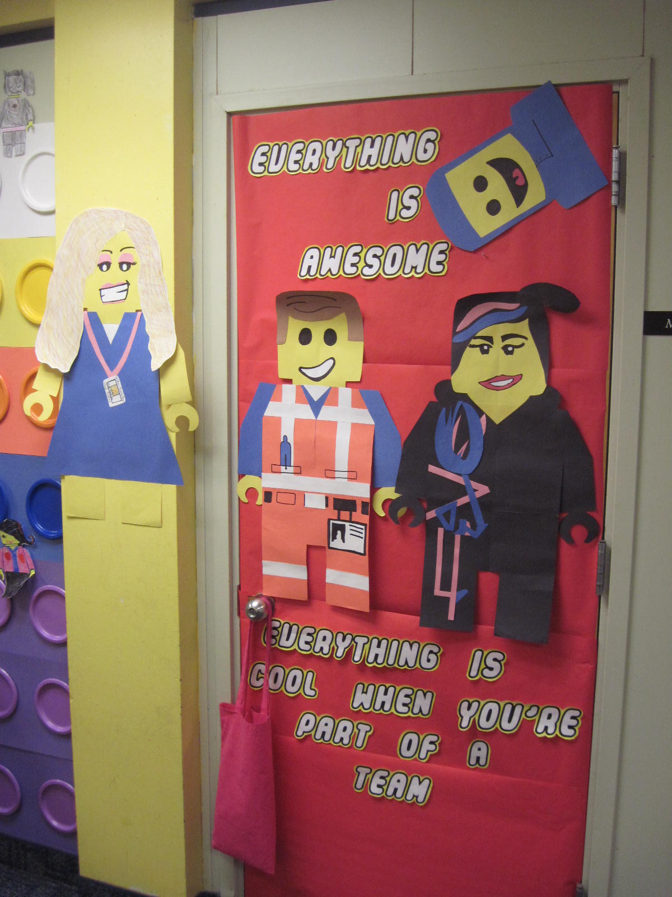
3rd Grade Classroom Doors
3-3 Mrs. Carannante
3-4 Ms. Medvec

Slide 14
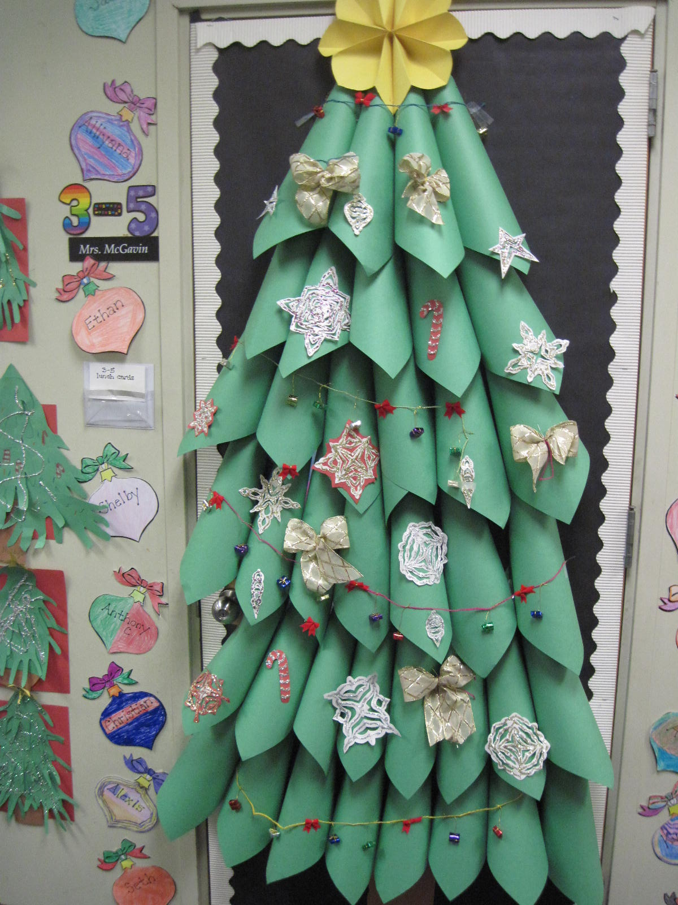
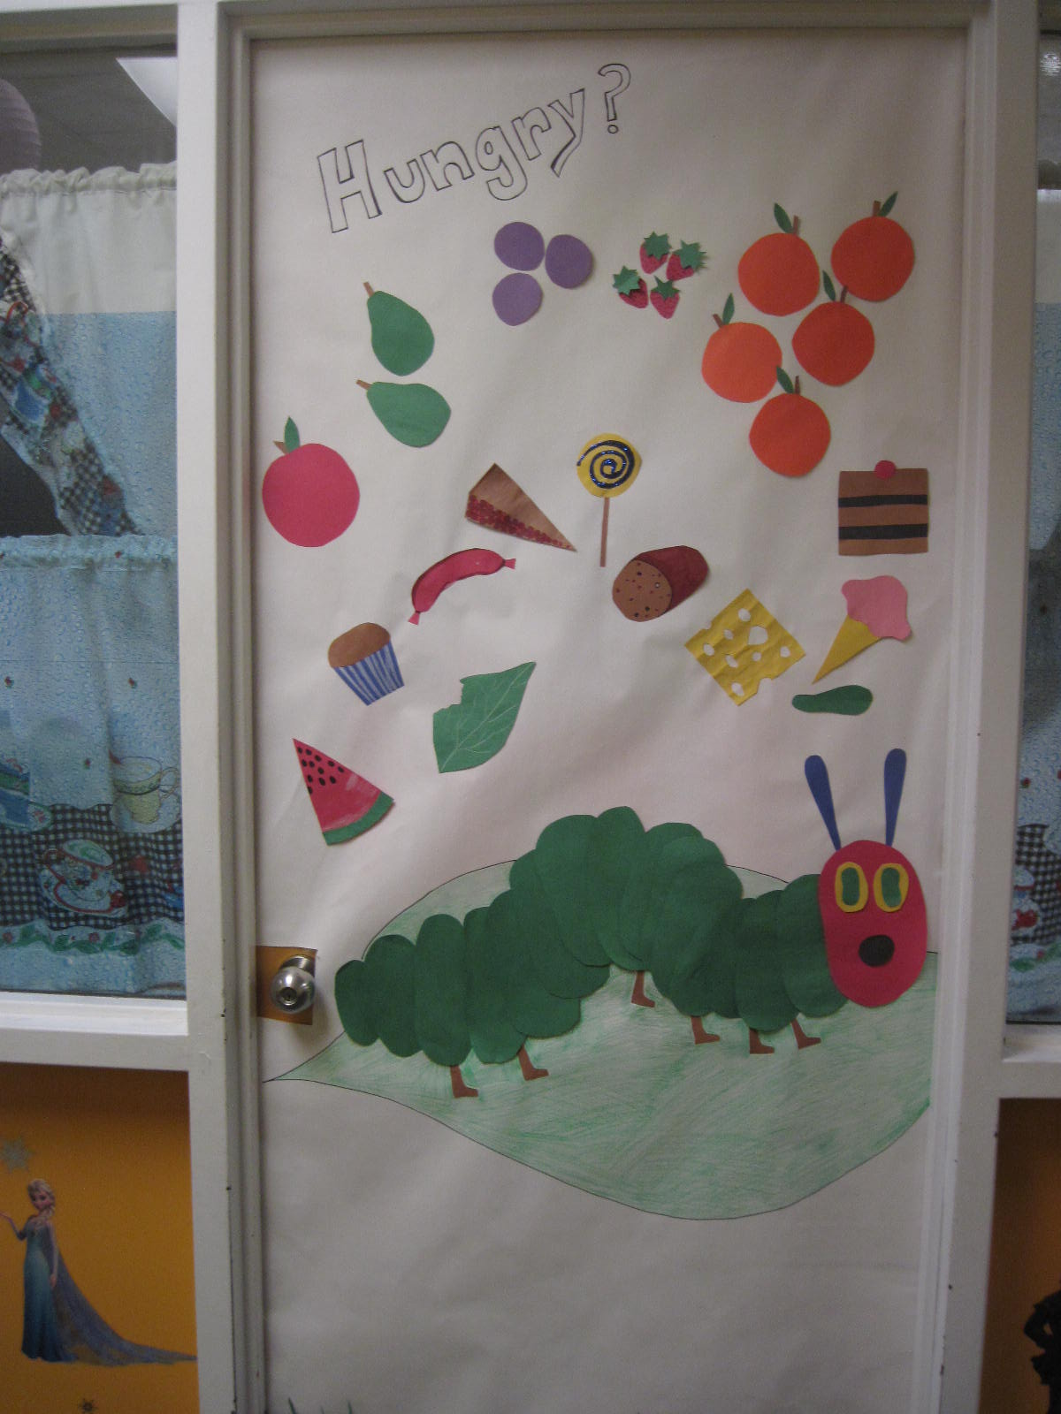
3rd Grade Classroom Doors
3-5 Mrs. McGavin
Title 1- Hendler/Volpetti

Slide 15
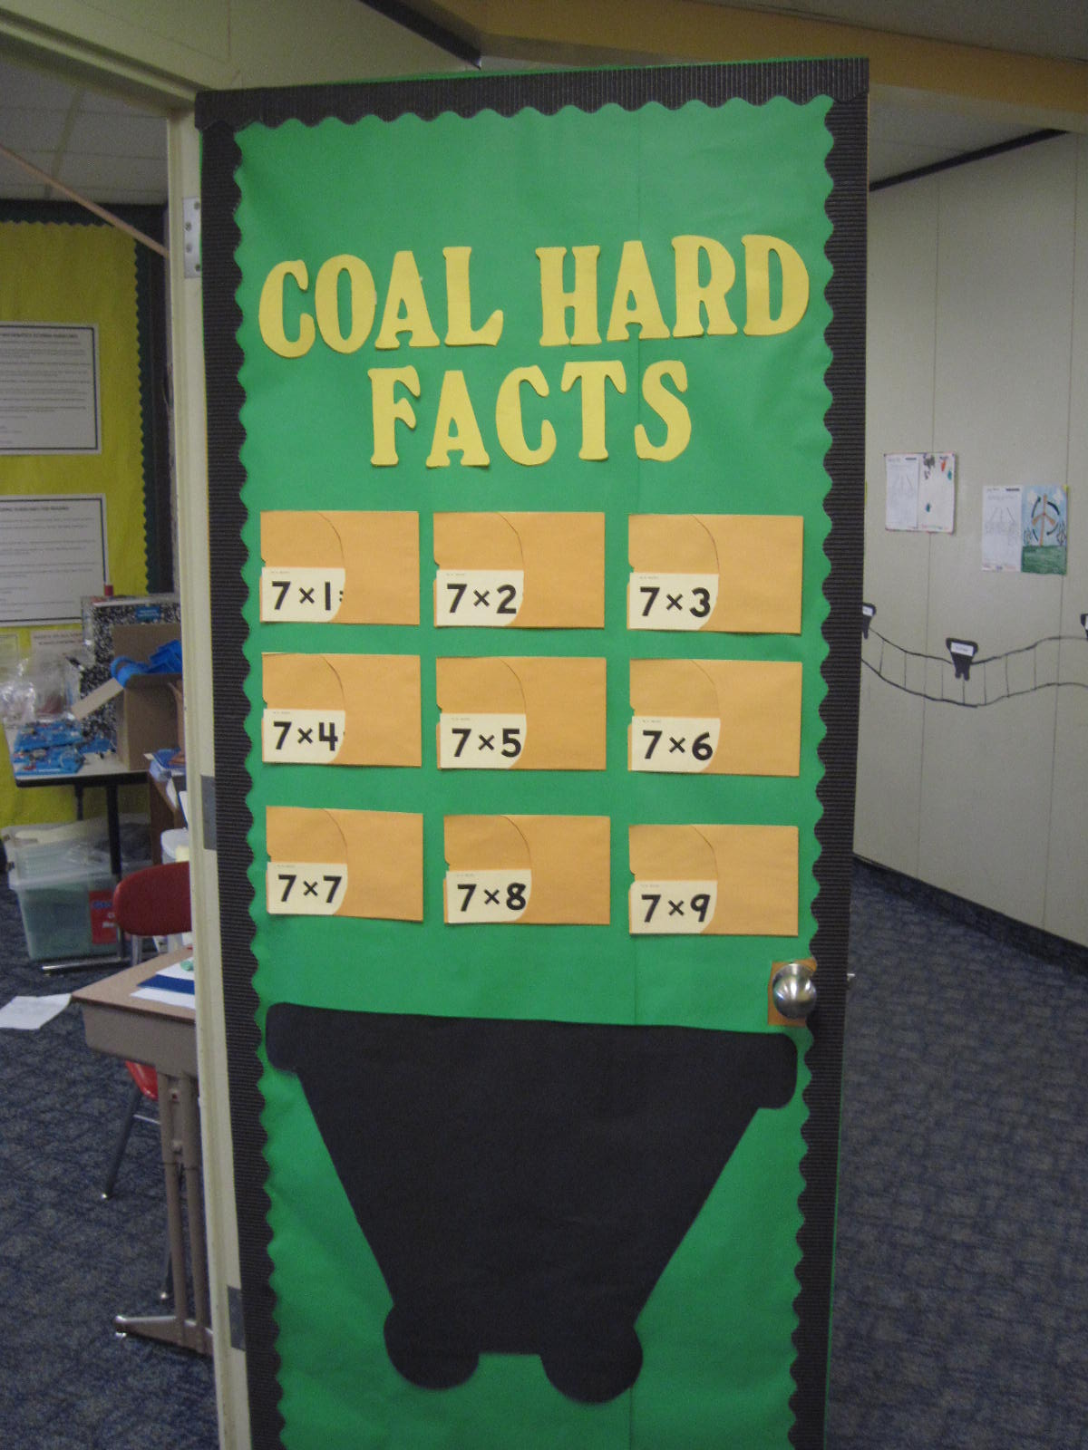
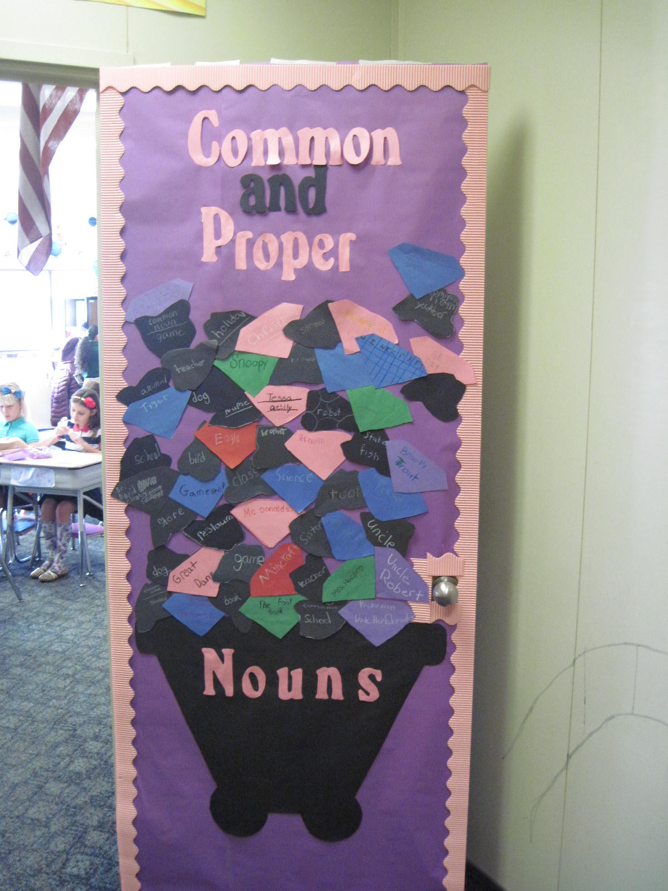
4th Grade Classroom Doors
4-1 Mrs. Harding
4-2 Mrs. Southern

Slide 16
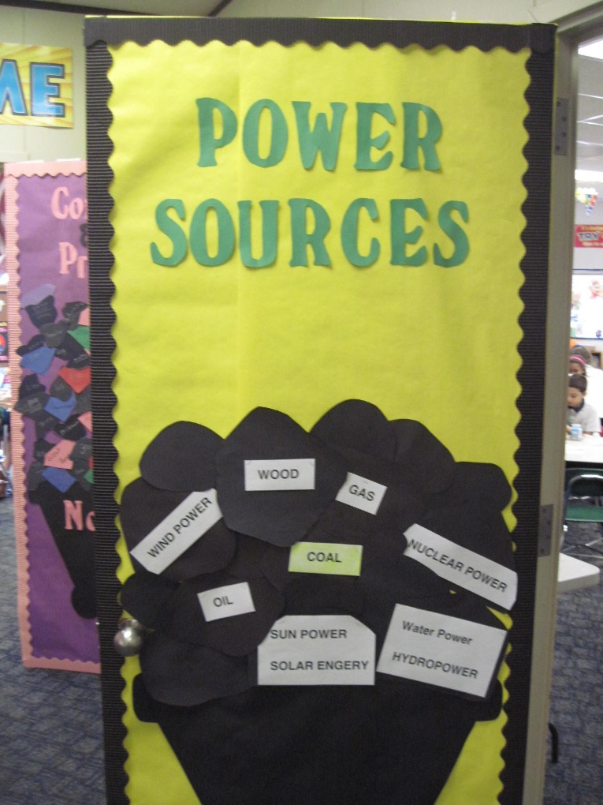
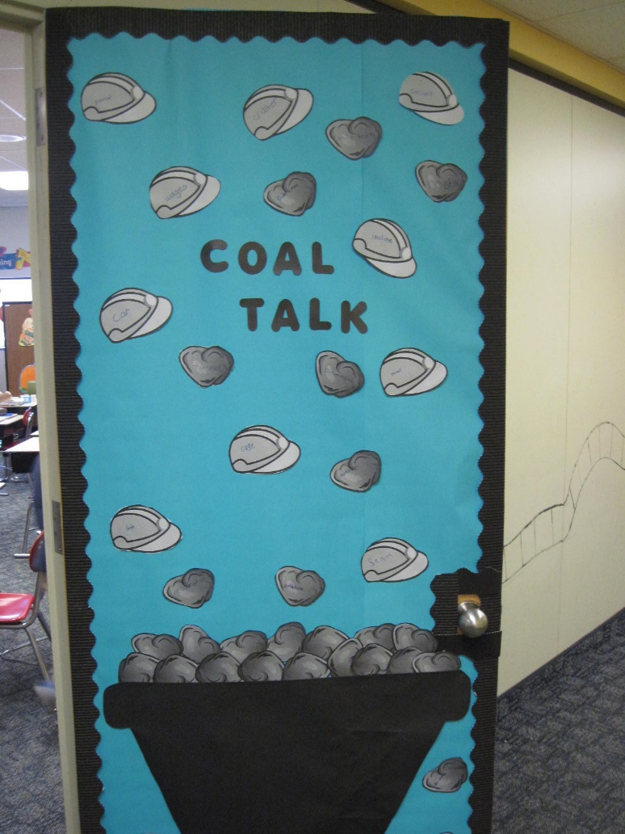
4th Grade Classroom Doors
4-3 Mrs. Tobin
4-4 Mrs. Christian

Slide 17
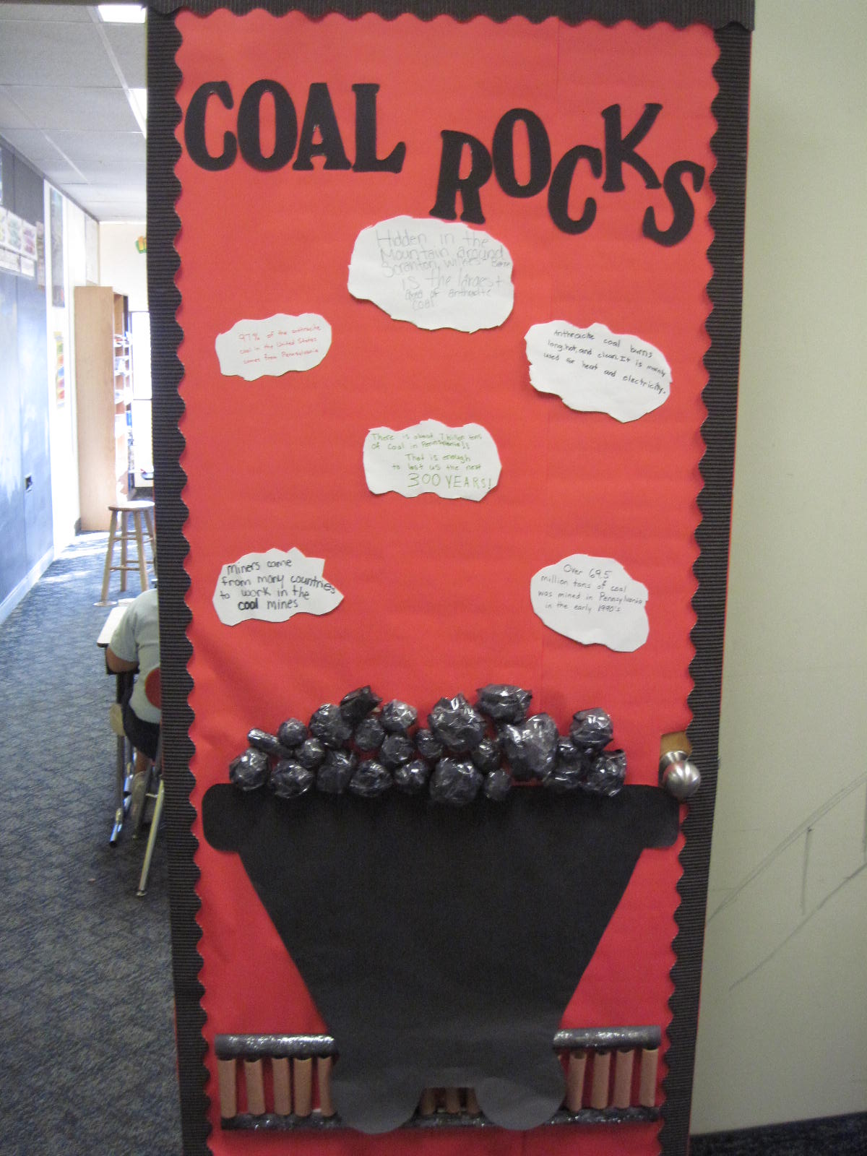
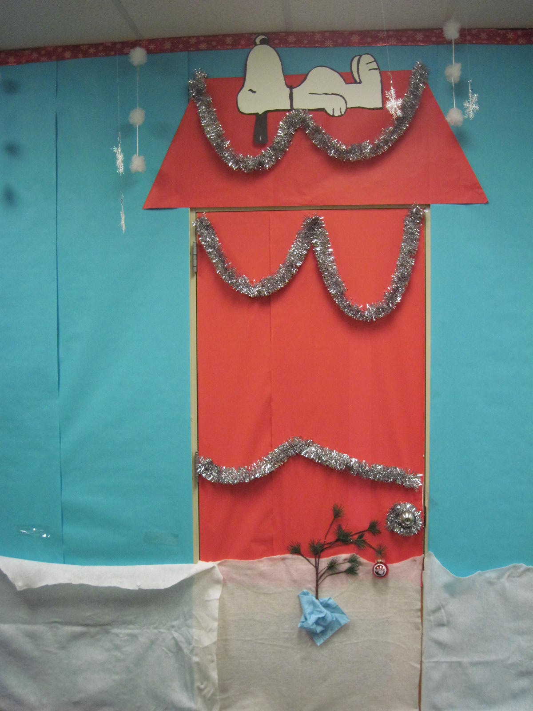
4th Grade Classroom Doors
4-5 Ms. Mushock
L.S. Ms. McGettigan

Slide 18
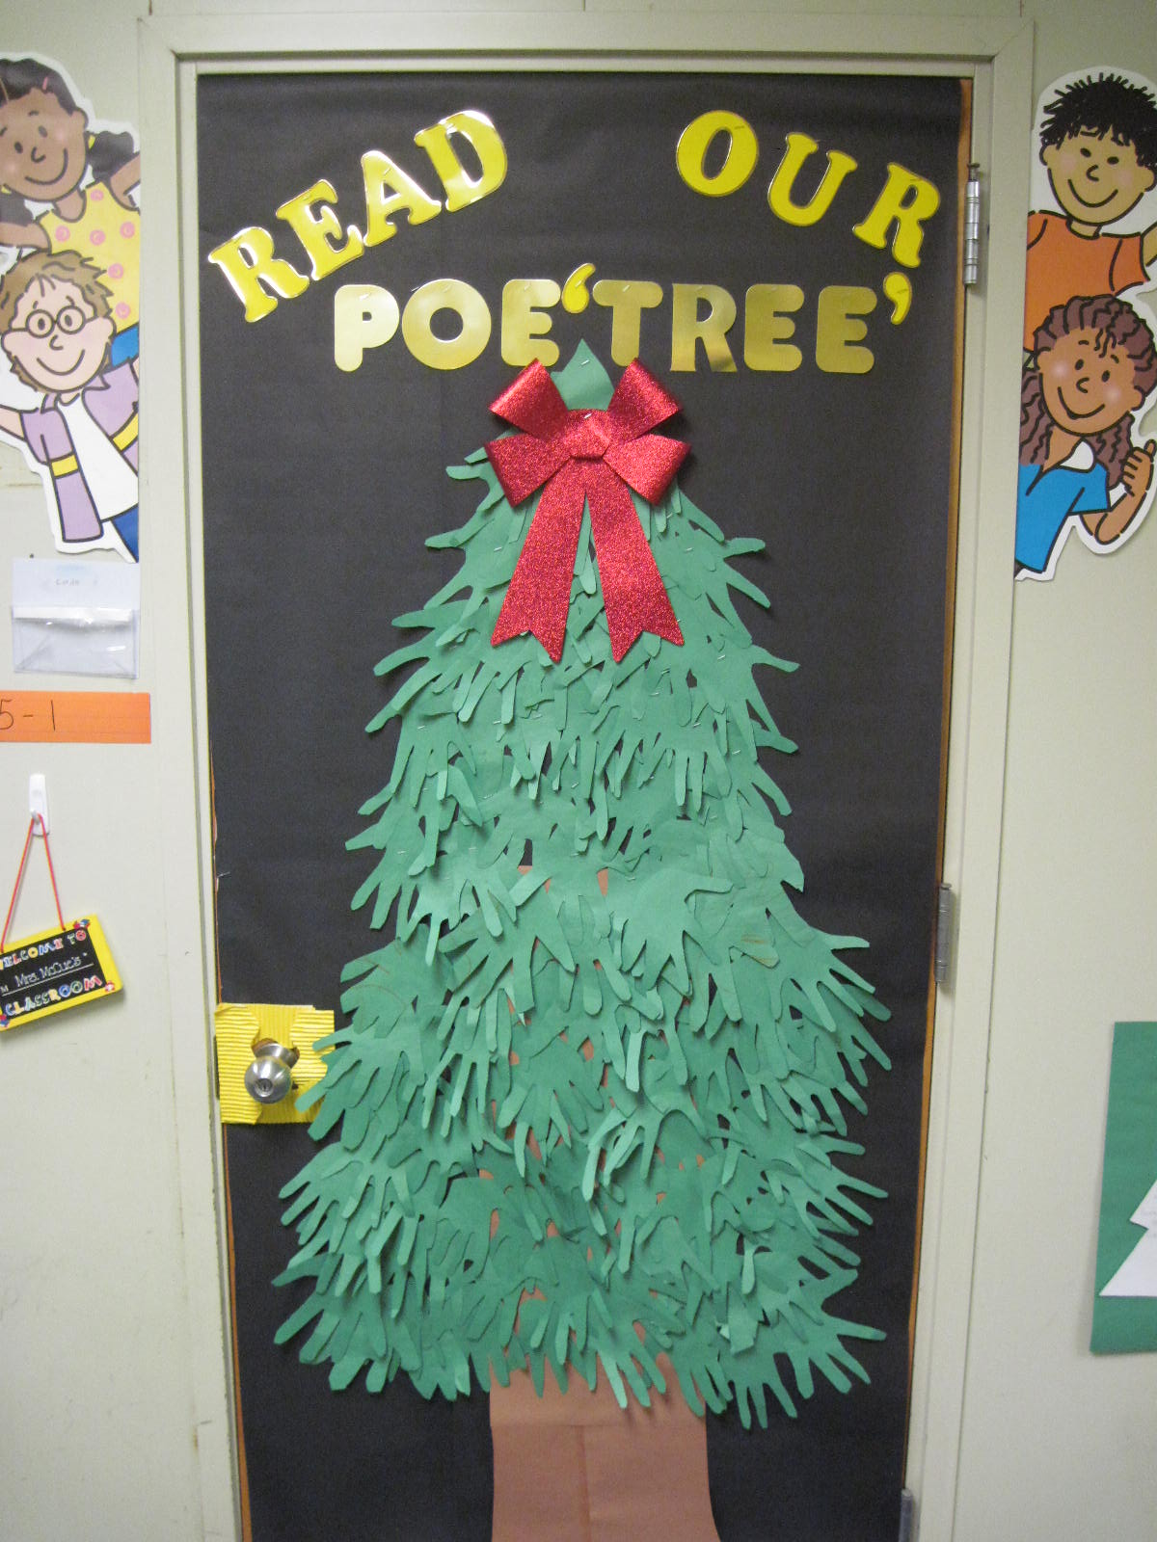
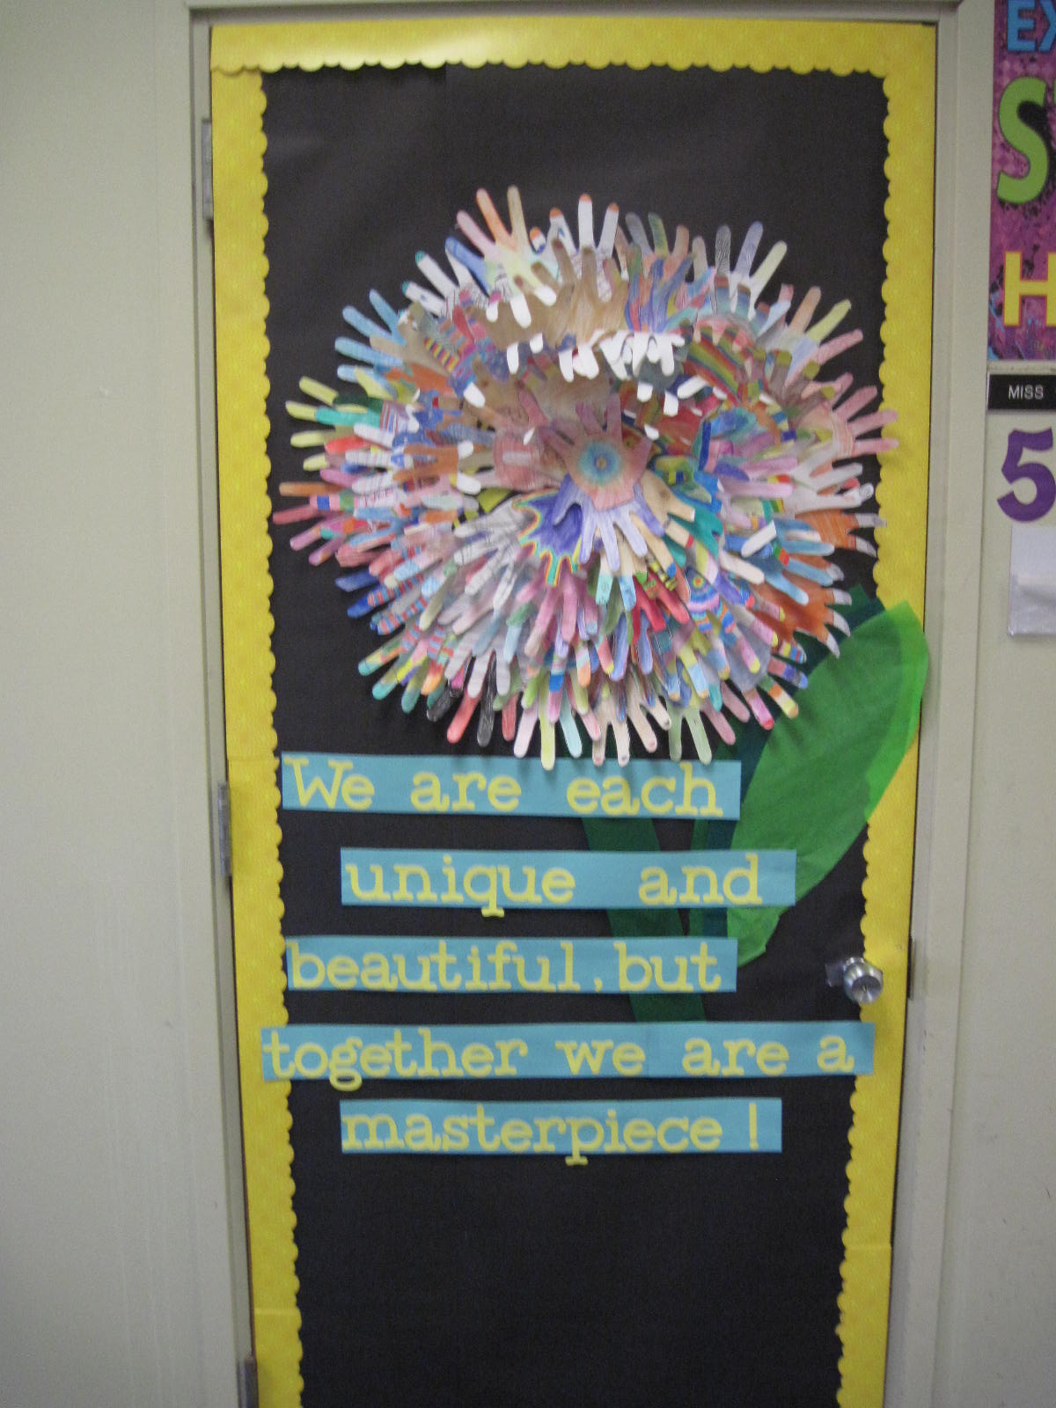
5th Grade Classroom Doors
5-1 Mrs. McCue
5-2 Ms. Craig

Slide 19
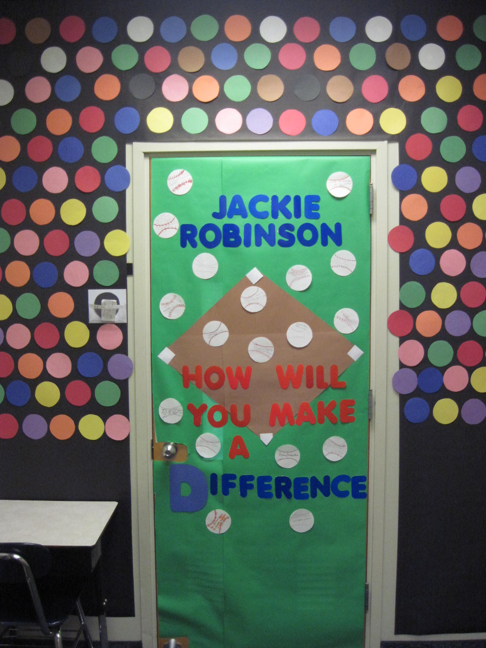
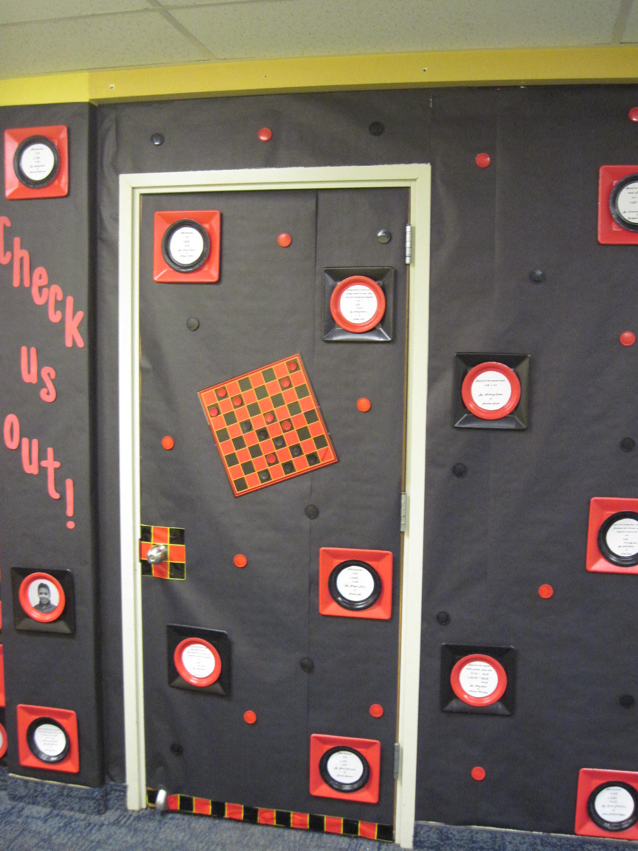
5th Grade Classroom Doors
5-3 Mrs. Vought
5-4 Mrs. Sullivan

Slide 20
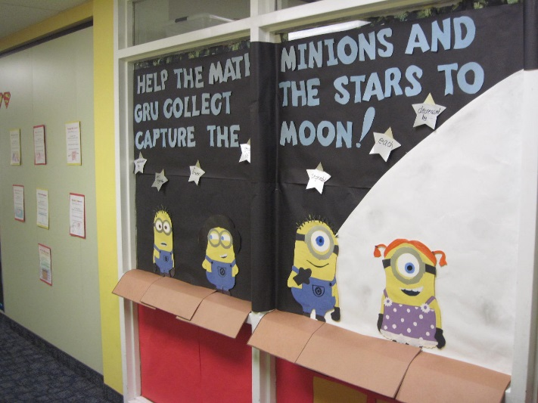
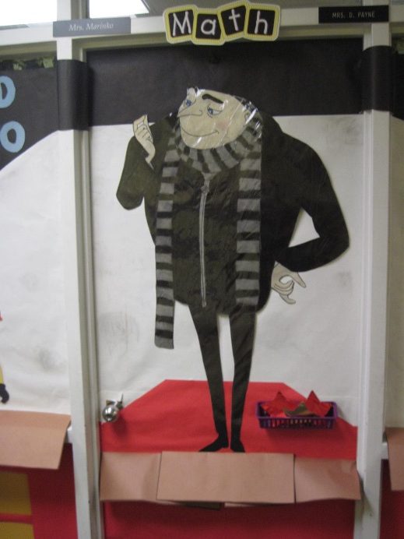
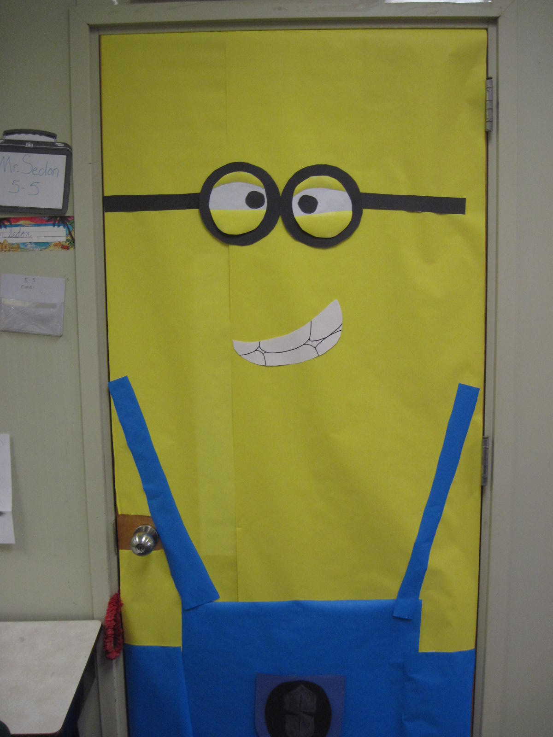
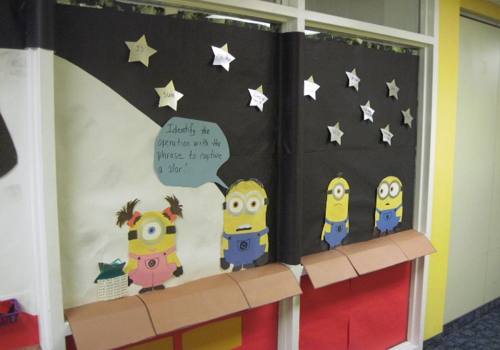
5th Grade Classroom Doors
5-5 Mr. Sedon
Title 1 Payne/Markino

Slide 21
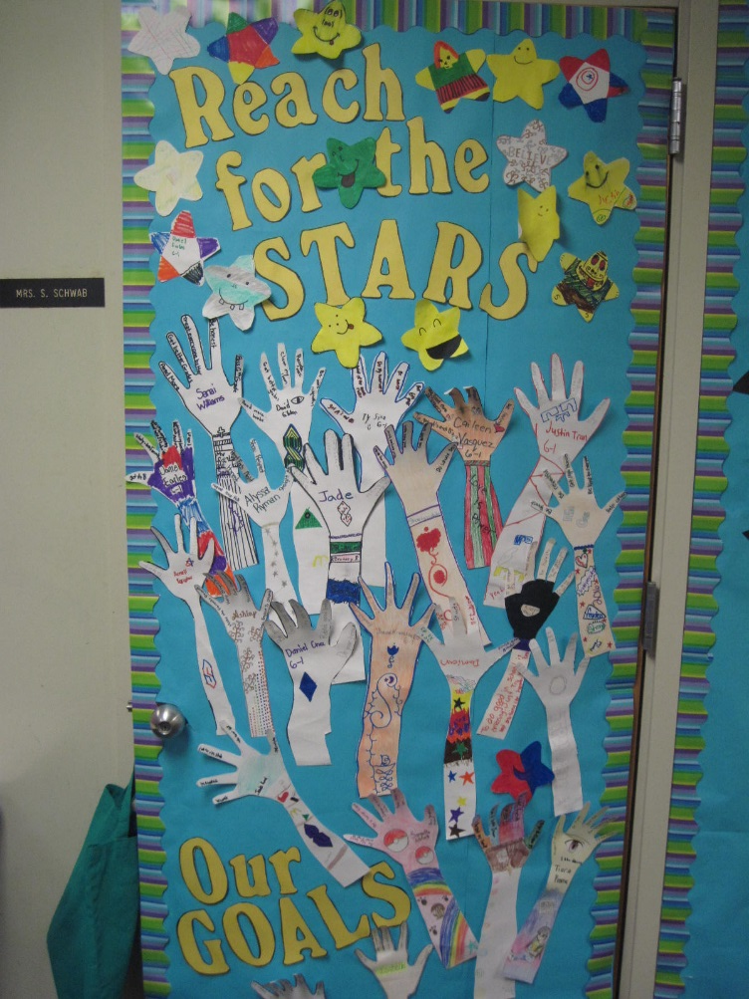
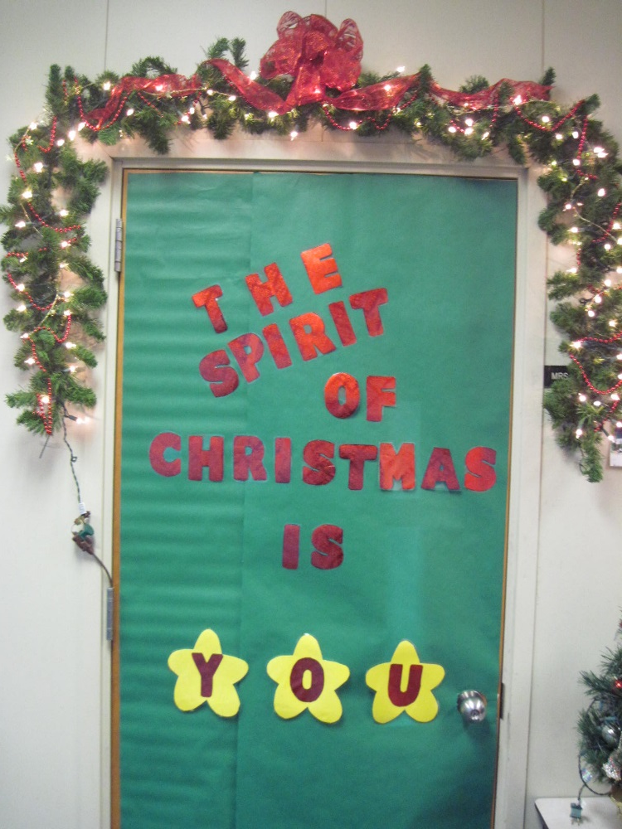
6th Grade Classroom Doors
6-1 Mrs. Schwab
6-2 Mrs. Harris

Slide 22
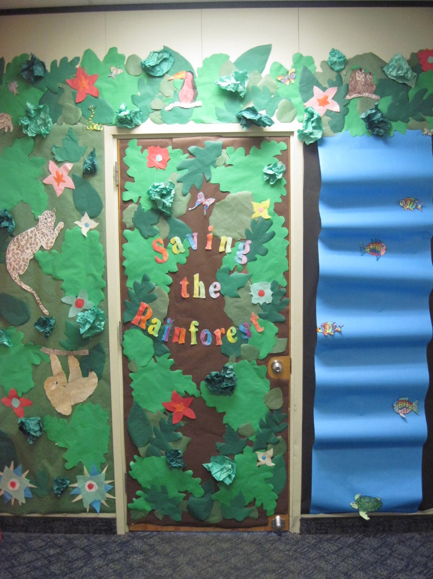
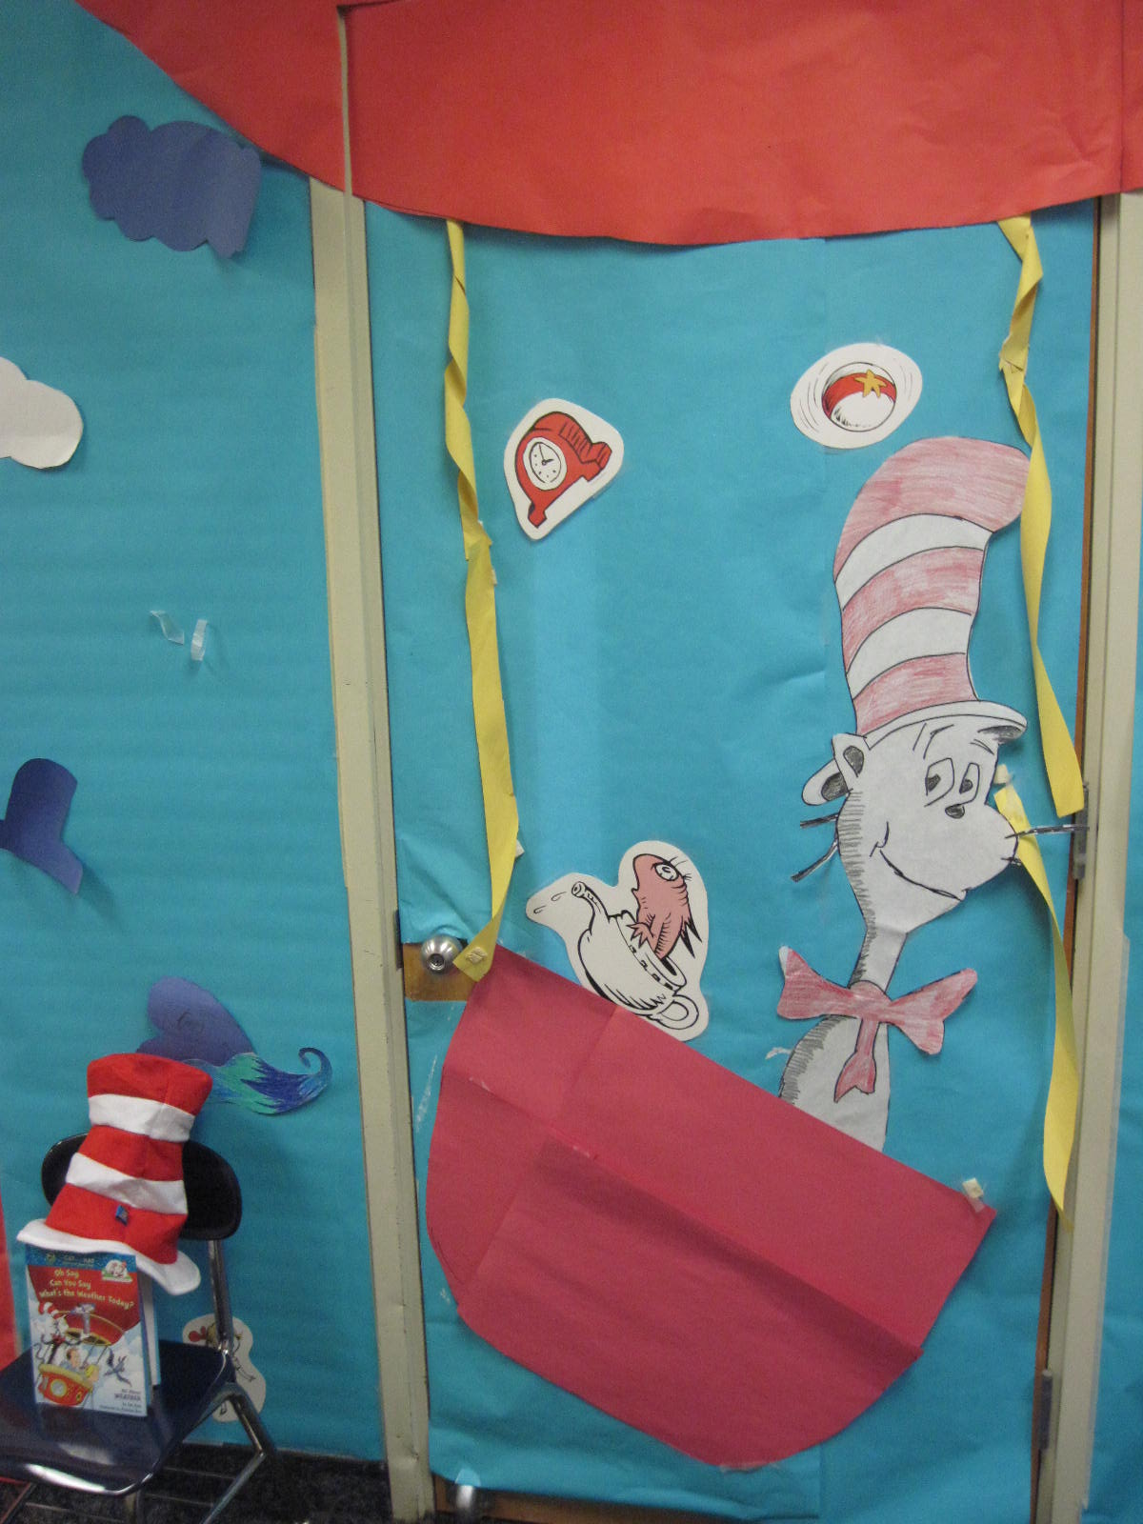
6th Grade Classroom Doors
6-3 Mrs. Fellerman
6-4 Mr. Mercadanate

Slide 23
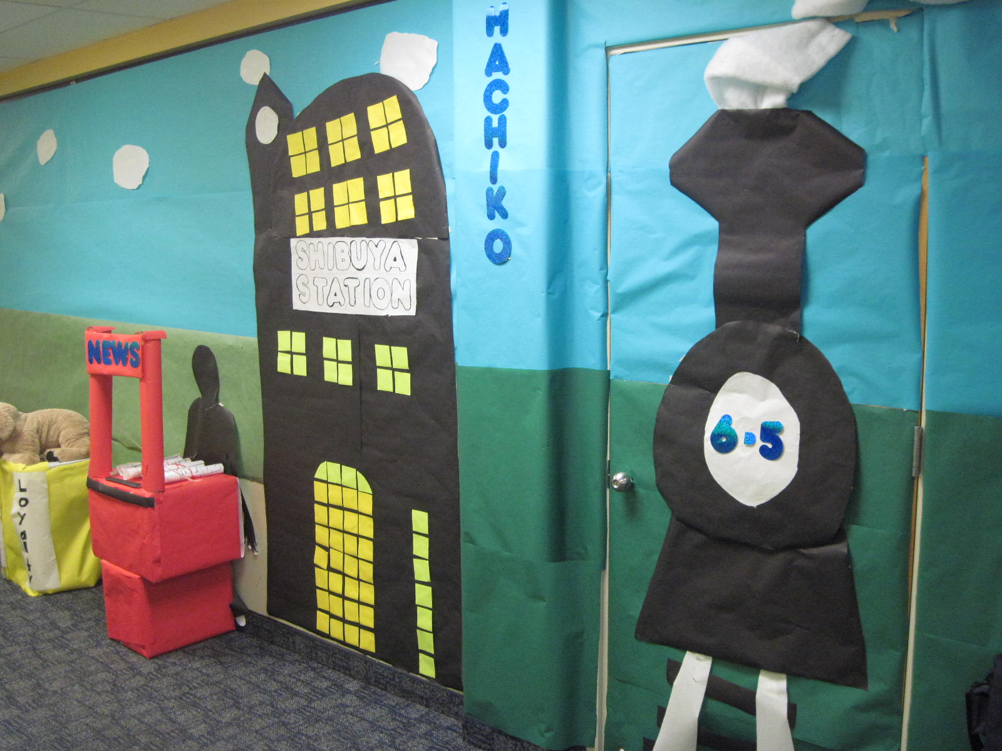
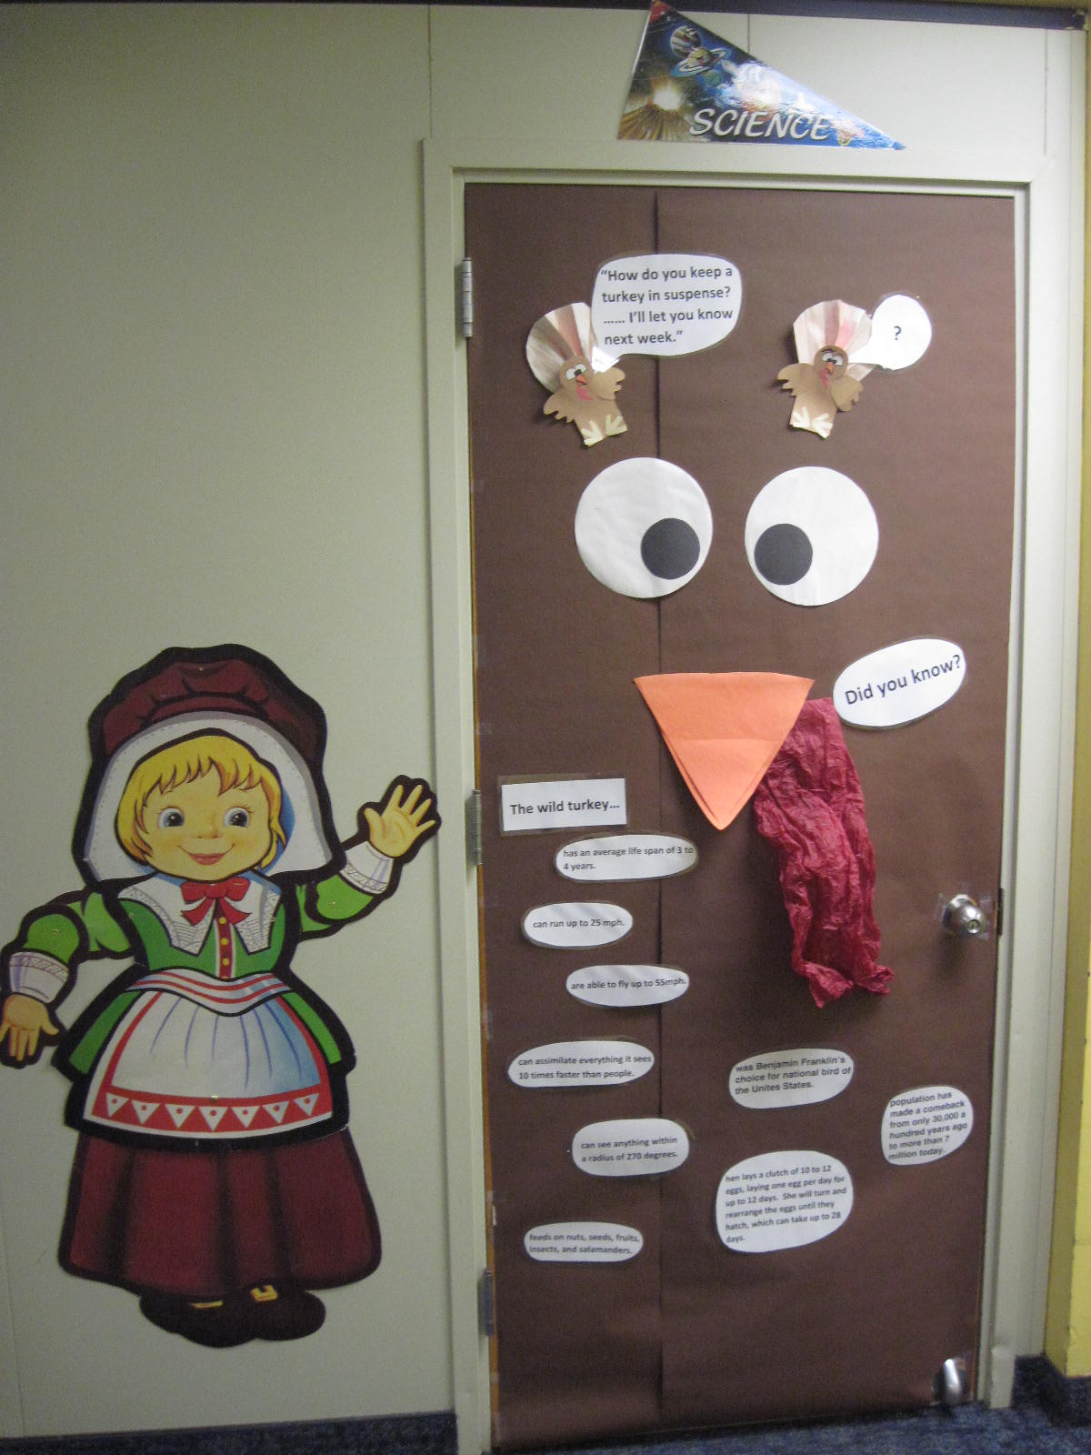
6th Grade Classroom Doors
6-5 Mrs. Hillard
G.S. Mr. McHenry

Slide 24
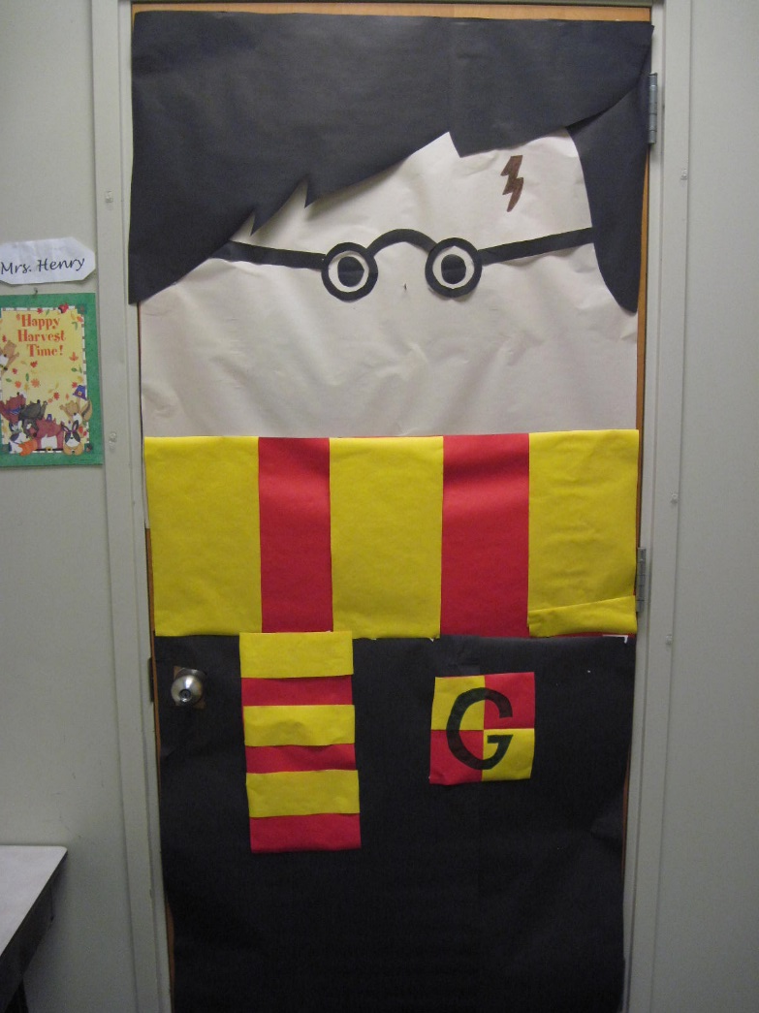
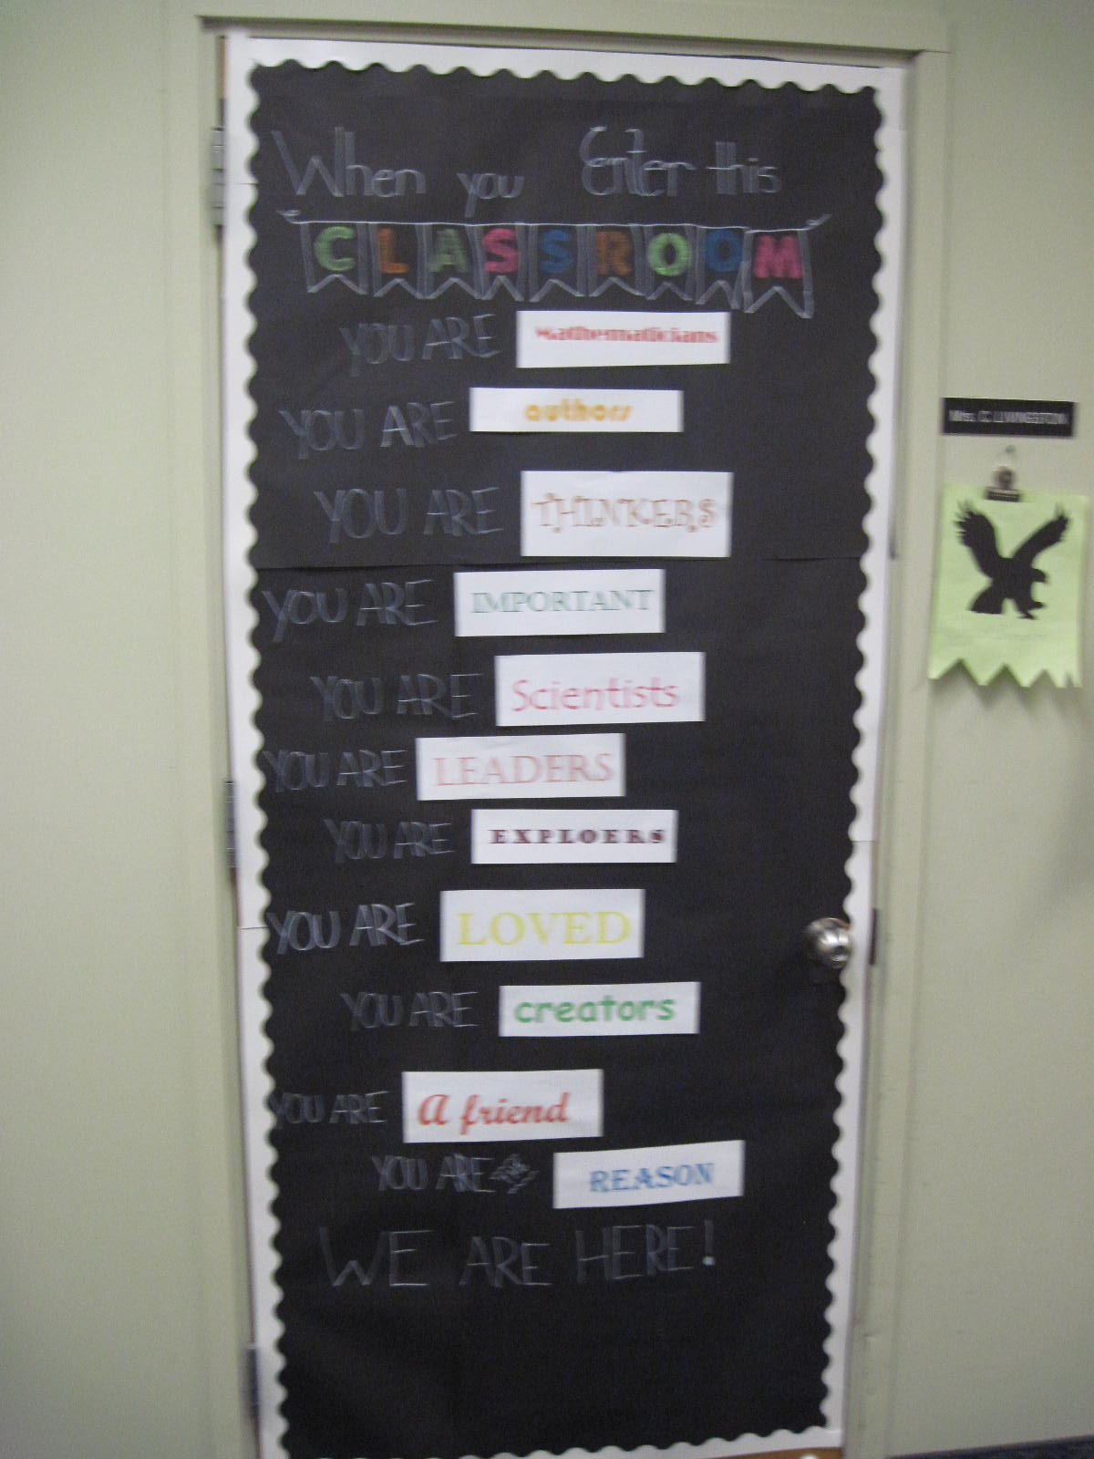
Gifted Support Classroom Doors
G.S. Mrs. Henry
G.S. Mrs. Livingston

Slide 25
Specialist Classroom Doors
Mr. Grimes
Mrs. Grendzinski

Slide 26
Specialist Classroom Doors
Mrs. Stanorski
Mrs. Coyne

Slide 27
Specialist Classroom Doors
Ms. Pstrak
IST/SPEECH

Slide 28
Specialist Classroom Doors
Mrs. Gavlick
Mrs. Jackson

Slide 29
Specialist Classroom Doors
Mrs. Mikiewicz
Mrs. Atherton/Ms. Nilon

Slide 30
Cast Your Ballot!
SIMPLY COMPLETE THE PARENT/GUARDIAN VOTING FORM AND PLACE IT IN THE BOX OUTSIDE THE MAIN OFFICE!
THANK YOU FOR YOUR VISIT TO KISTLER ELEMENTARY SCHOOL

